Slide 1
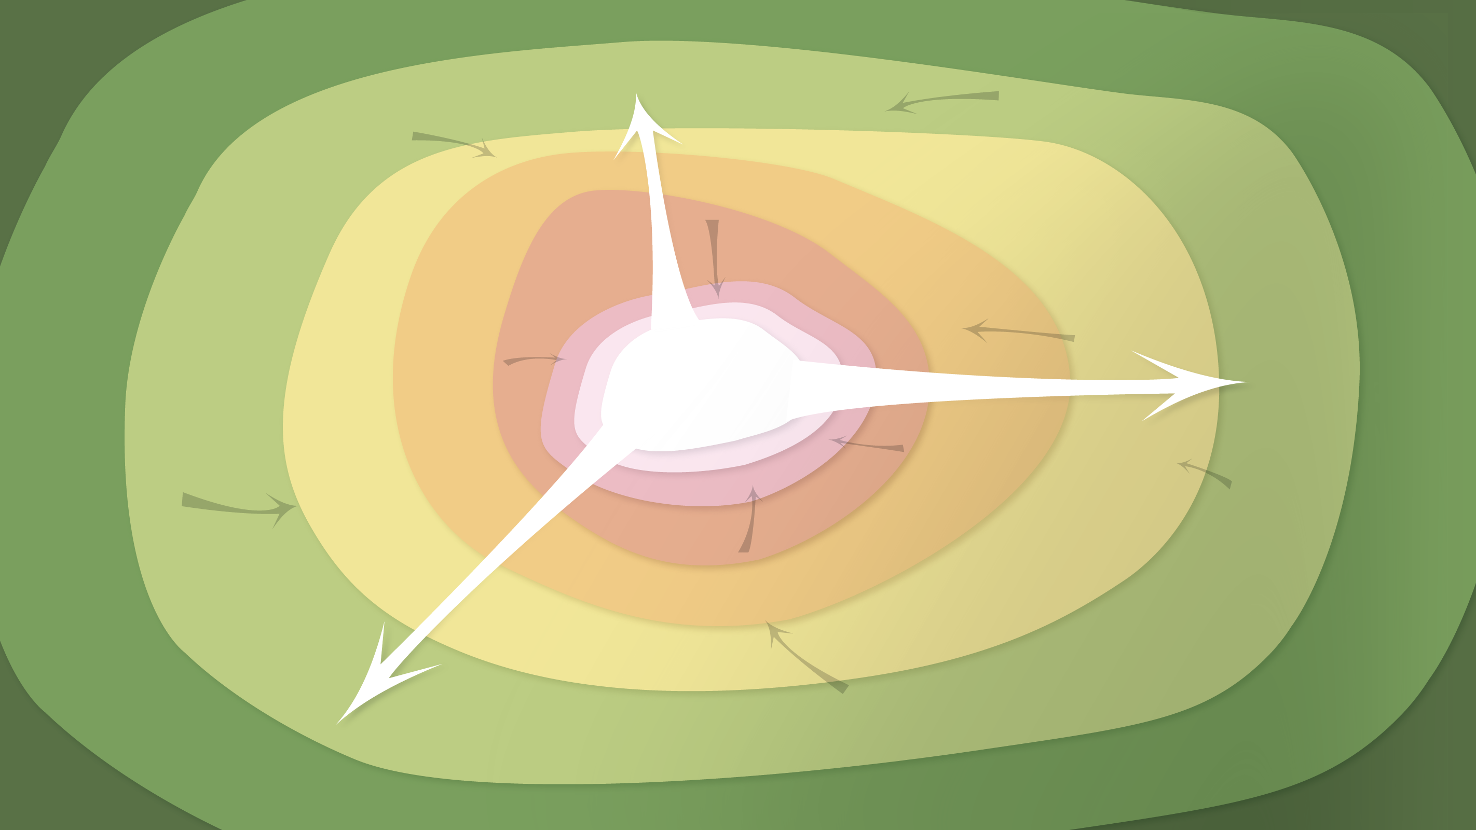
Data Management in the Research Environment
RSM 574/674 Spring 2016
Timothy Norris – tnorris@miami.edu
Angela Clark – aclark@rsmas.miami.edu

Slide 2
Todays Topics Data Curation Profiles
What is a DCP
The toolkit
An example
Discussion

Slide 3
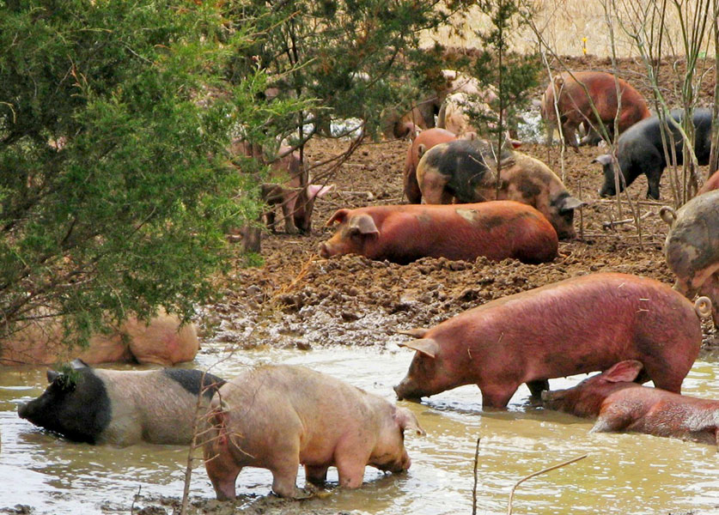
Curation?

Slide 4
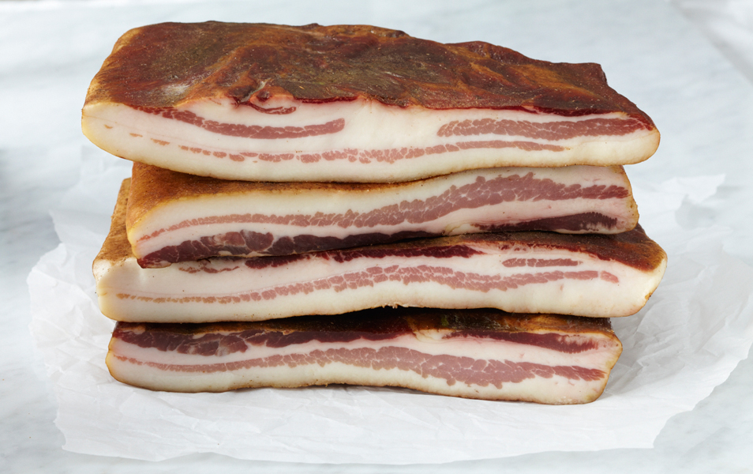
Curation?

Slide 5

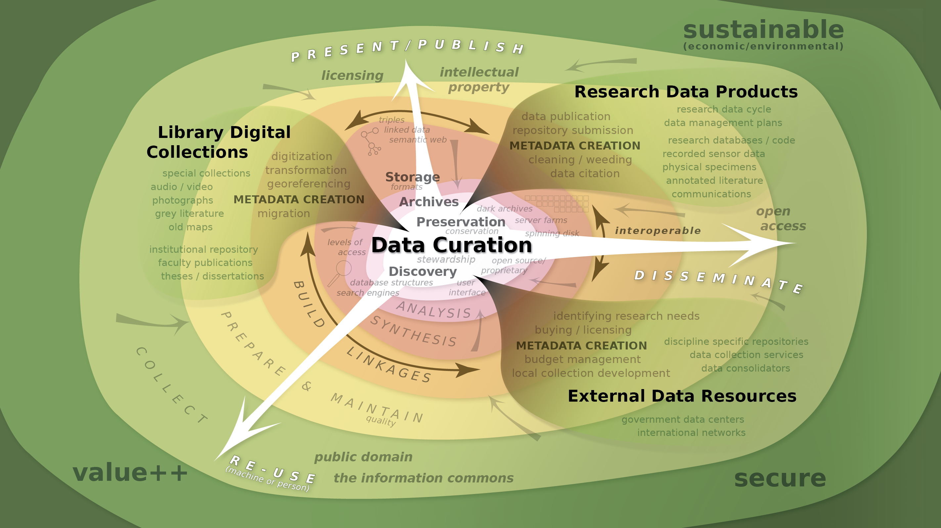
Notes:
So we are left with this complex view (strategic pause)
Re-emphasize the role of the curator as a collaborator in the creation of metadata and a builder of relationships.
Copyright and access metadata? Who polices? Is the metadata stable? Are links persistant? GATEKEEPERS
(illustrator 20)

Slide 6
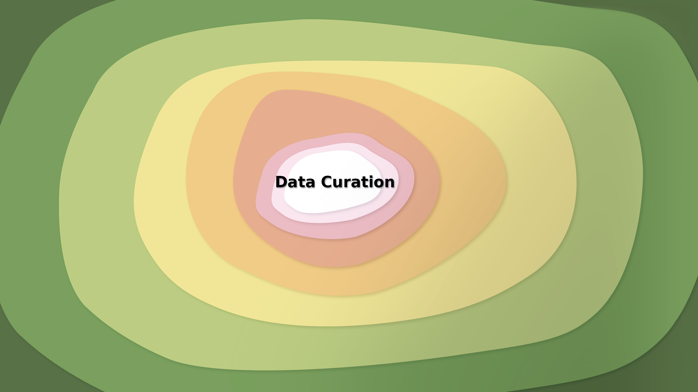
Notes:
The map as metaphor. This is how one non-librarian approaches thinking about data curation. The ideas that follow are drawn from library science literature, but the conception is that of a non-expert.
Perhaps brief intro to geography research – geospatial data heavy research.
First use of the term Data Curation in 1995 in a somewhat obscure paper in the journal Museum Management and Curatorship. The article: Zorich, D. M. (1995). Data management: Managing electronic information: Data curation in museums. Museum Management and Curatorship, 14(4), 430-432. Cited in: Palmer, C. L., Weber, N. M., Muñoz, T., and Renear, A. H. (2013). Foundations of Data Curation: The Pedagogy and Practice of “Purposeful Work” with Research Data. Archives Remixed.
First use of term Digital Curation in 2001 at a seminar held by the Digital Preservation Coalition and the British National Space Center on October 19th 2001 in London - Beagrie, N. (2008). Digital Curation for Science, Digital Libraries, and Individuals. International Journal of Digital Curation, 1(1), 3-16. doi: 10.2218/ijdc.v1i1.2
(illustrator 1)

Slide 7
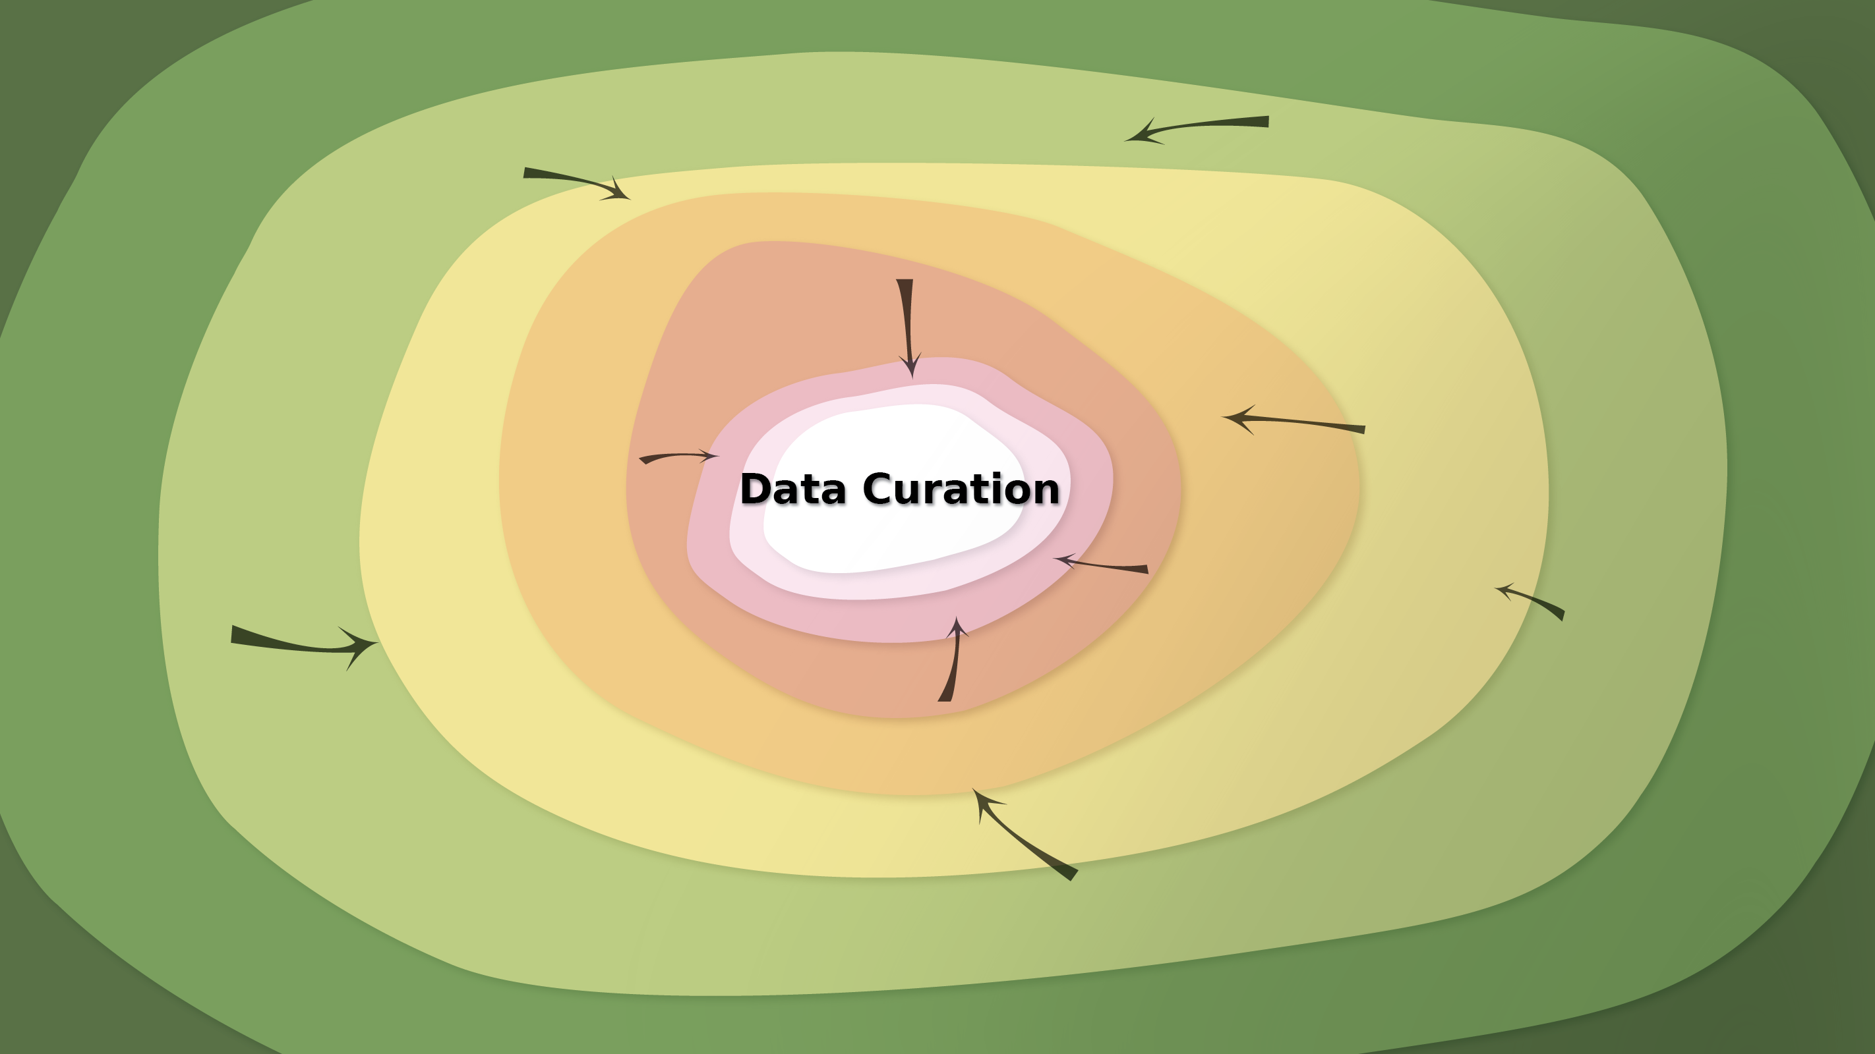
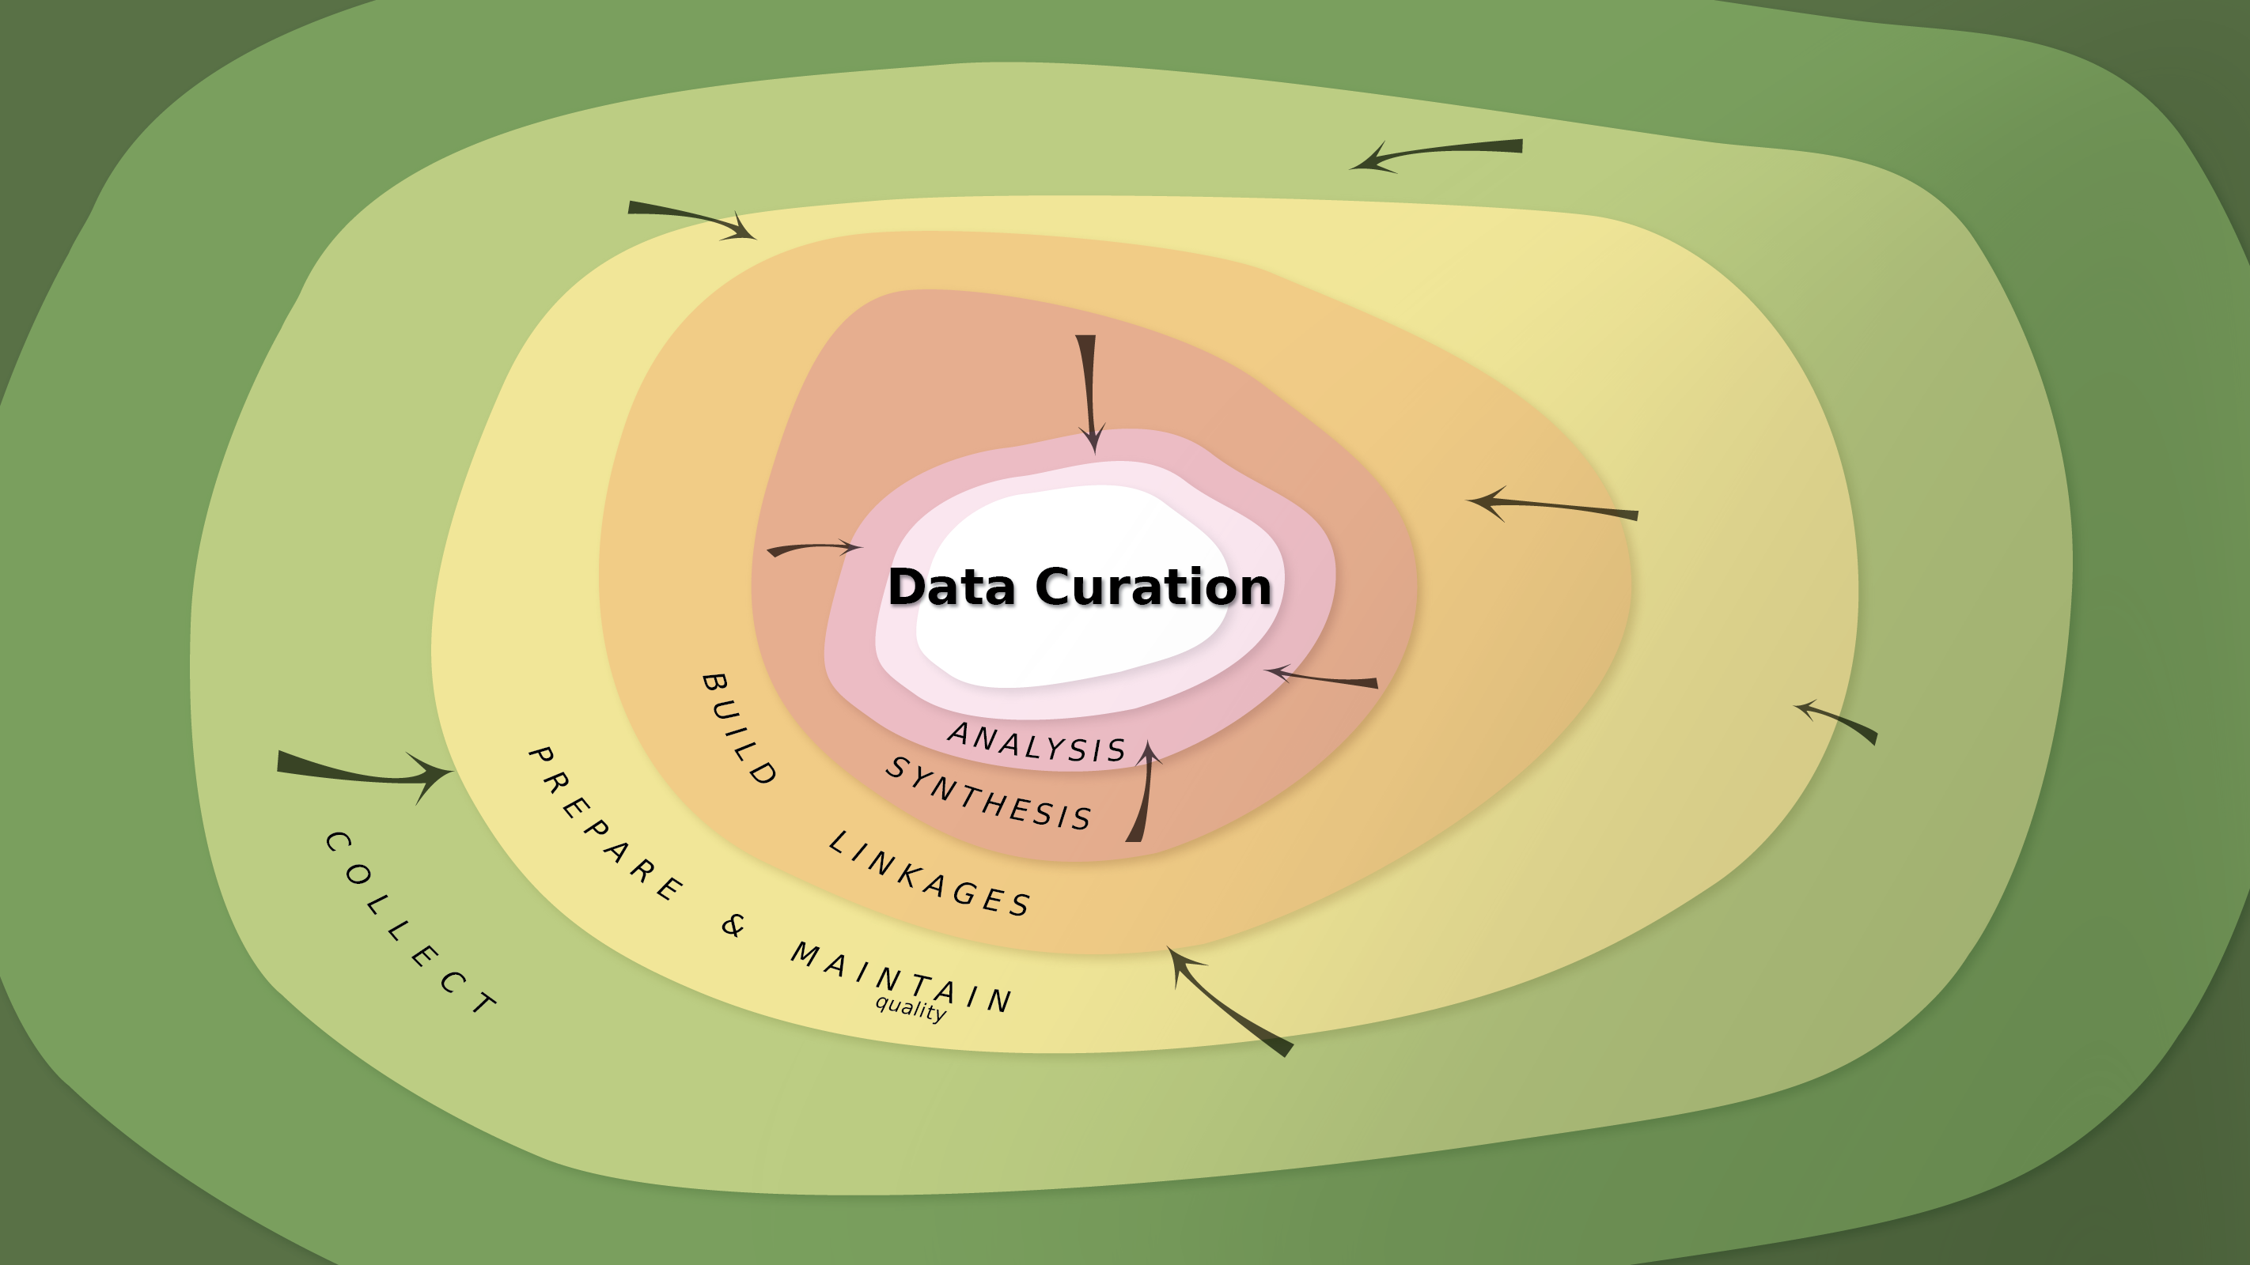

Slide 8
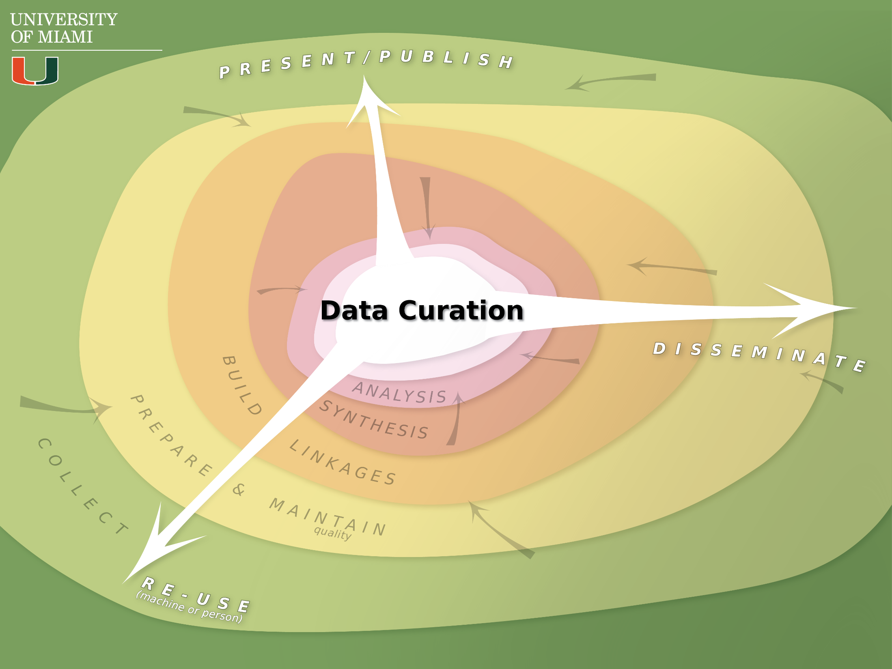
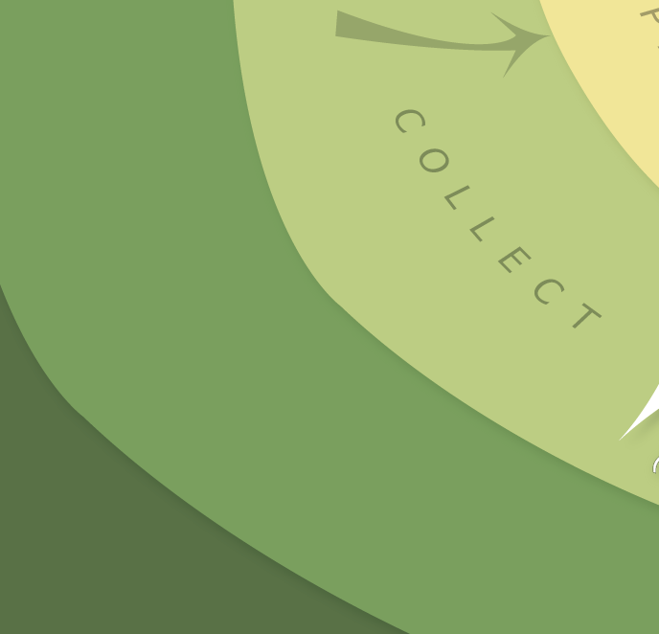
Notes:
Fry, William (1965). "Methods in Taxonomy." Nature 207: 245-246.
From Systematics Association meeting March 31 1965 on taxonomy at the British Museum of Natural History: New methods in Taxonomy can be grouped as: Collecting, preparation and maintenance, examination and extraction of information, analysis and synthesis, dissemination and presentation.
The third step has been modified slightly for this presentation (examination and extraction of information -> build linkages).
(illustrator 3)

Slide 9



Notes:
Re-mention the difference between preservation-conservation and suggest the term stewardship of curation of data. Stewardship as safeguarding the valuables of others and a suggestion of being responsible towards issues of sustainability.

Slide 10
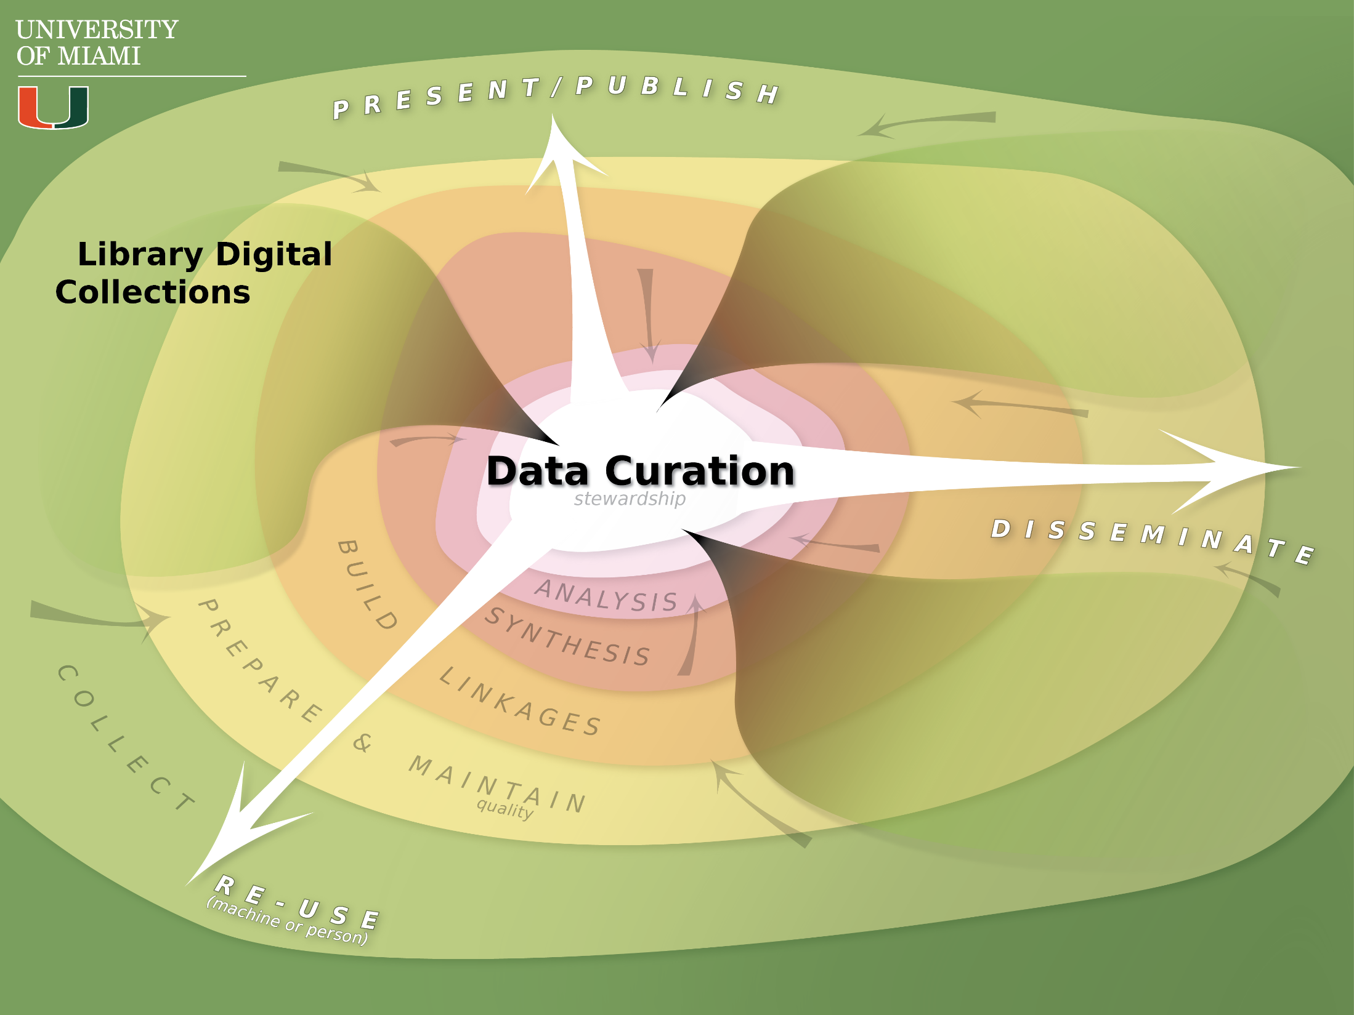
Notes:
A very general abstraction, thinking about what goes into and comes out from the process of curation. There are no hard boundaries between the three (library, research, and external)
(illustrator 4)

Slide 11
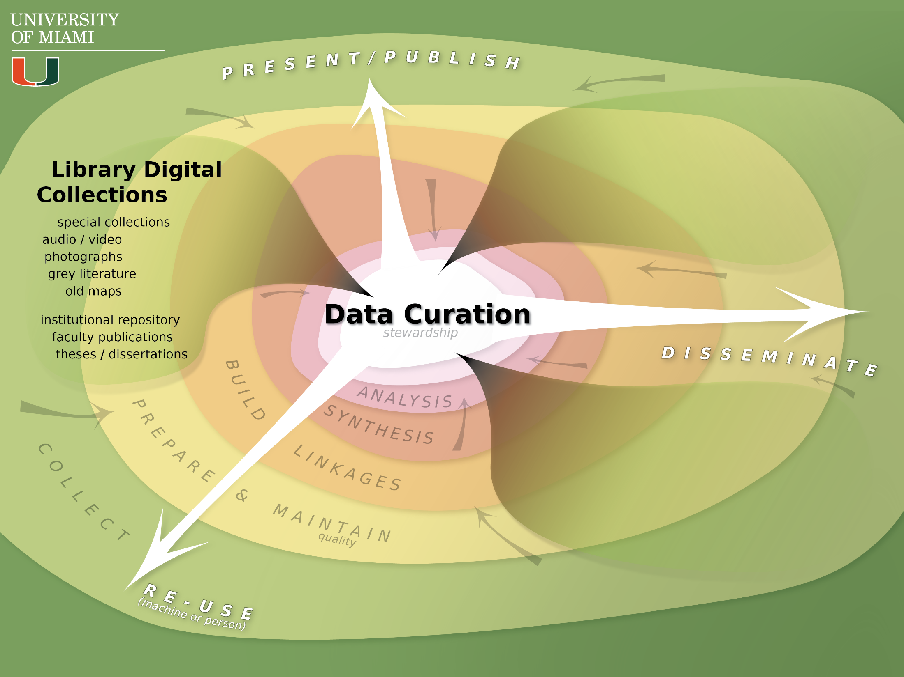
Notes:
A very general abstraction, thinking about what goes into and comes out from the process of curation. There are no hard boundaries between the three (library, research, and external)
(illustrator 4)

Slide 12

Notes:
Examples of Library Data Collections: Scholarly repositories, theses/dissertations, faculty publications (institutional repositories), scholarly repository, grey literature, oral histories, digitized manuscripts, finding aids and databases
(illustrator 5)

Slide 13
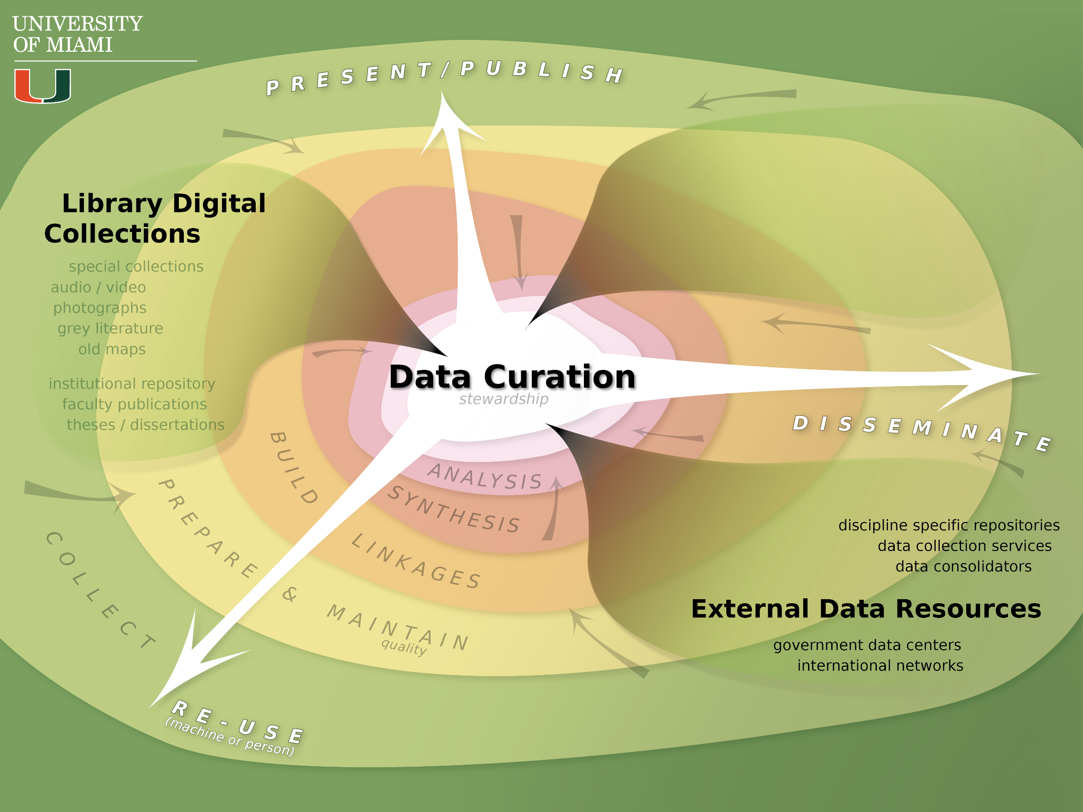
Notes:
Examples of External Data Resources: ICPSR (Inter-university Consortium for Political and Social Research), Hathi Trust, disciplinary repositories and networks (see DataBIB) [DataONE, DataVerse, Scholarly Publishing and Academic Resources Coalition (SPARC), Knowledge Network for Biocomplexity (KNB)]
Subscriptions? Connections to software licensing? Grant purchased data or license?
(illustrator 6)

Slide 14
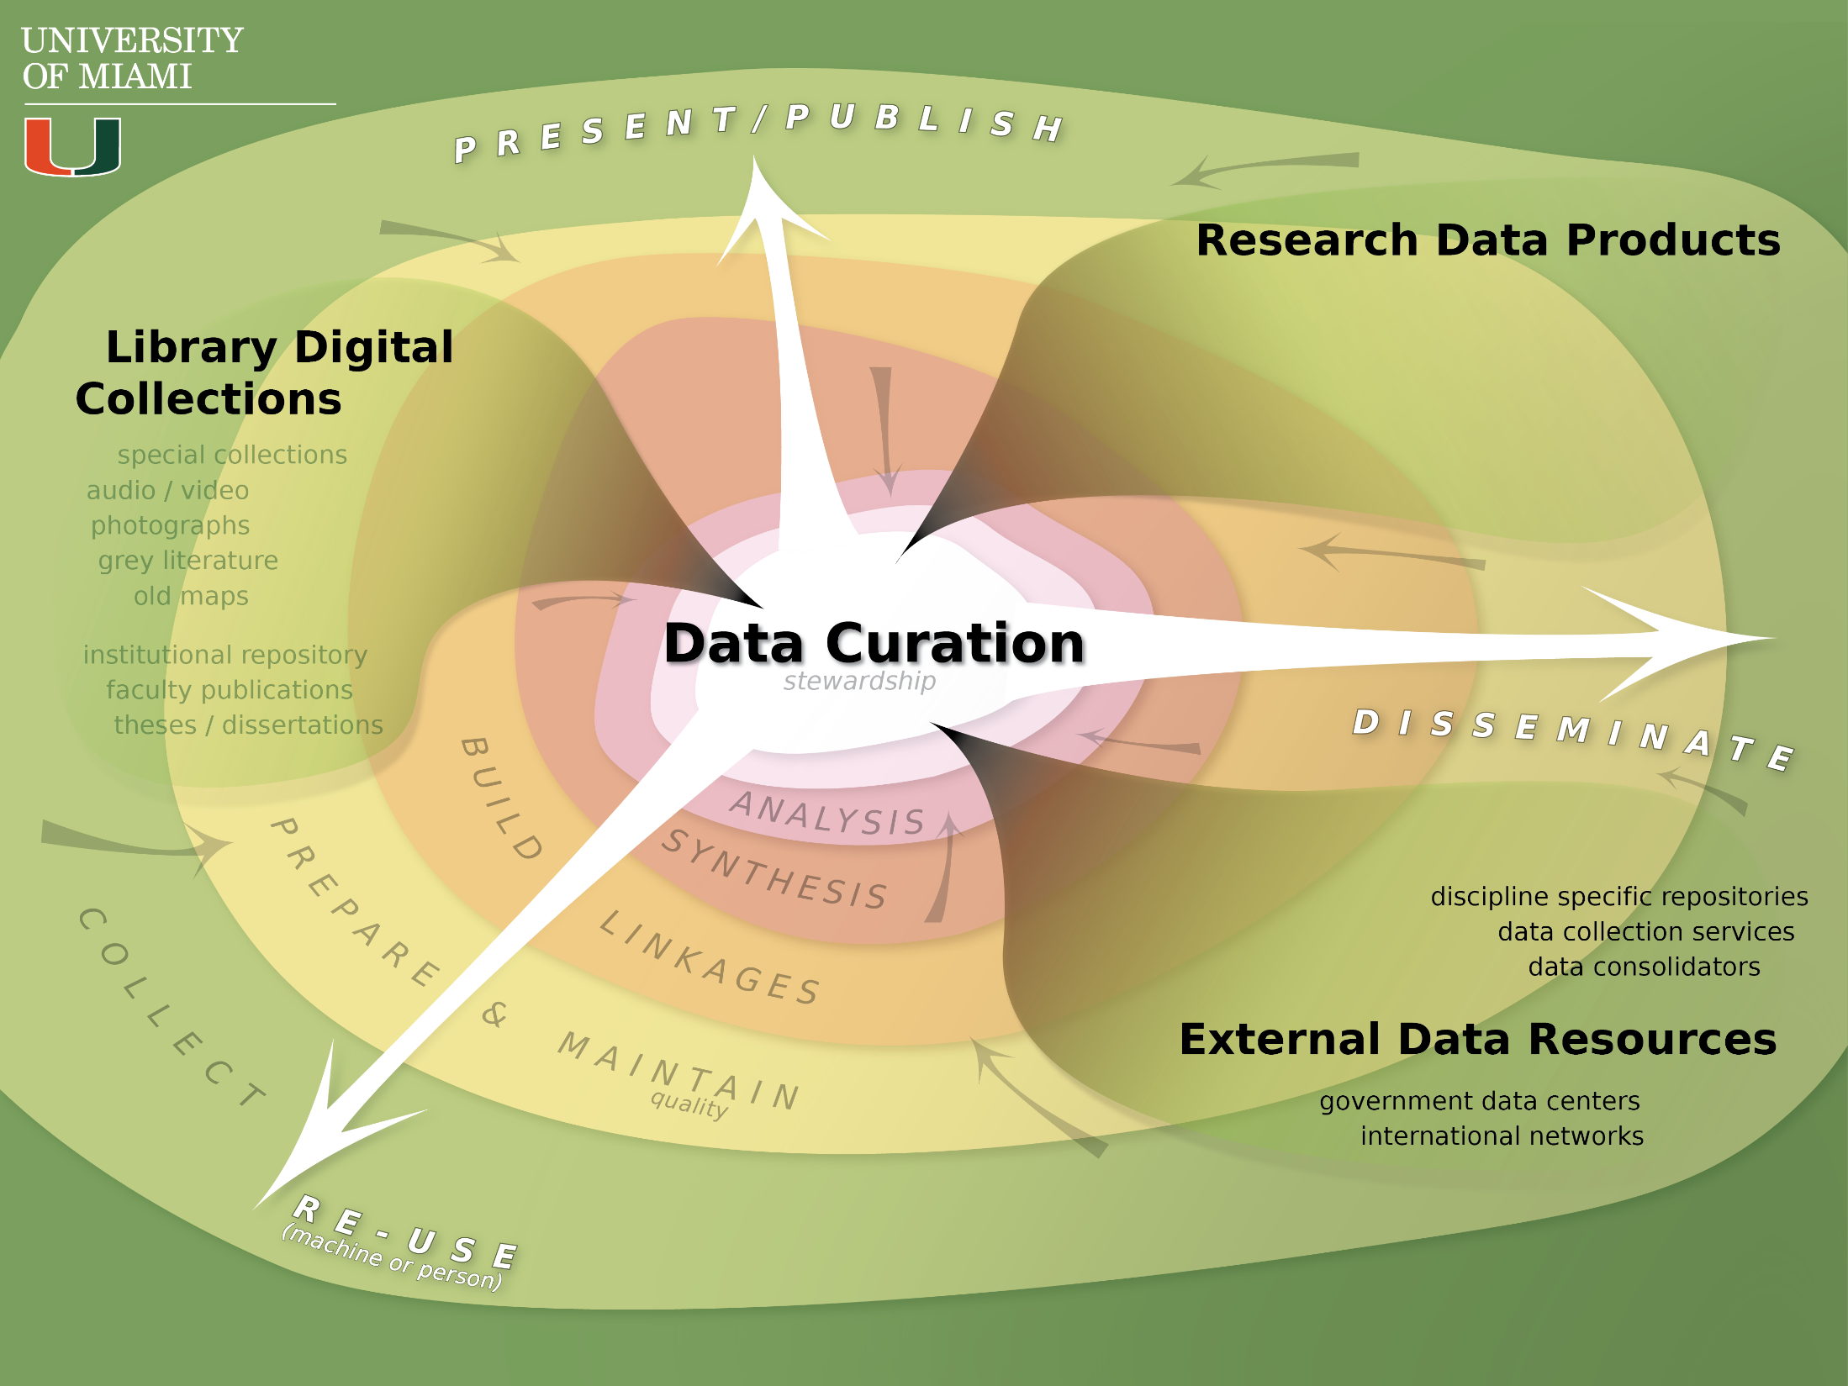
Notes:
Examples of External Data Resources: ICPSR (Inter-university Consortium for Political and Social Research), Hathi Trust, disciplinary repositories and networks (see DataBIB) [DataONE, DataVerse, Scholarly Publishing and Academic Resources Coalition (SPARC), Knowledge Network for Biocomplexity (KNB)]
Subscriptions? Connections to software licensing? Grant purchased data or license?
(illustrator 6)

Slide 15
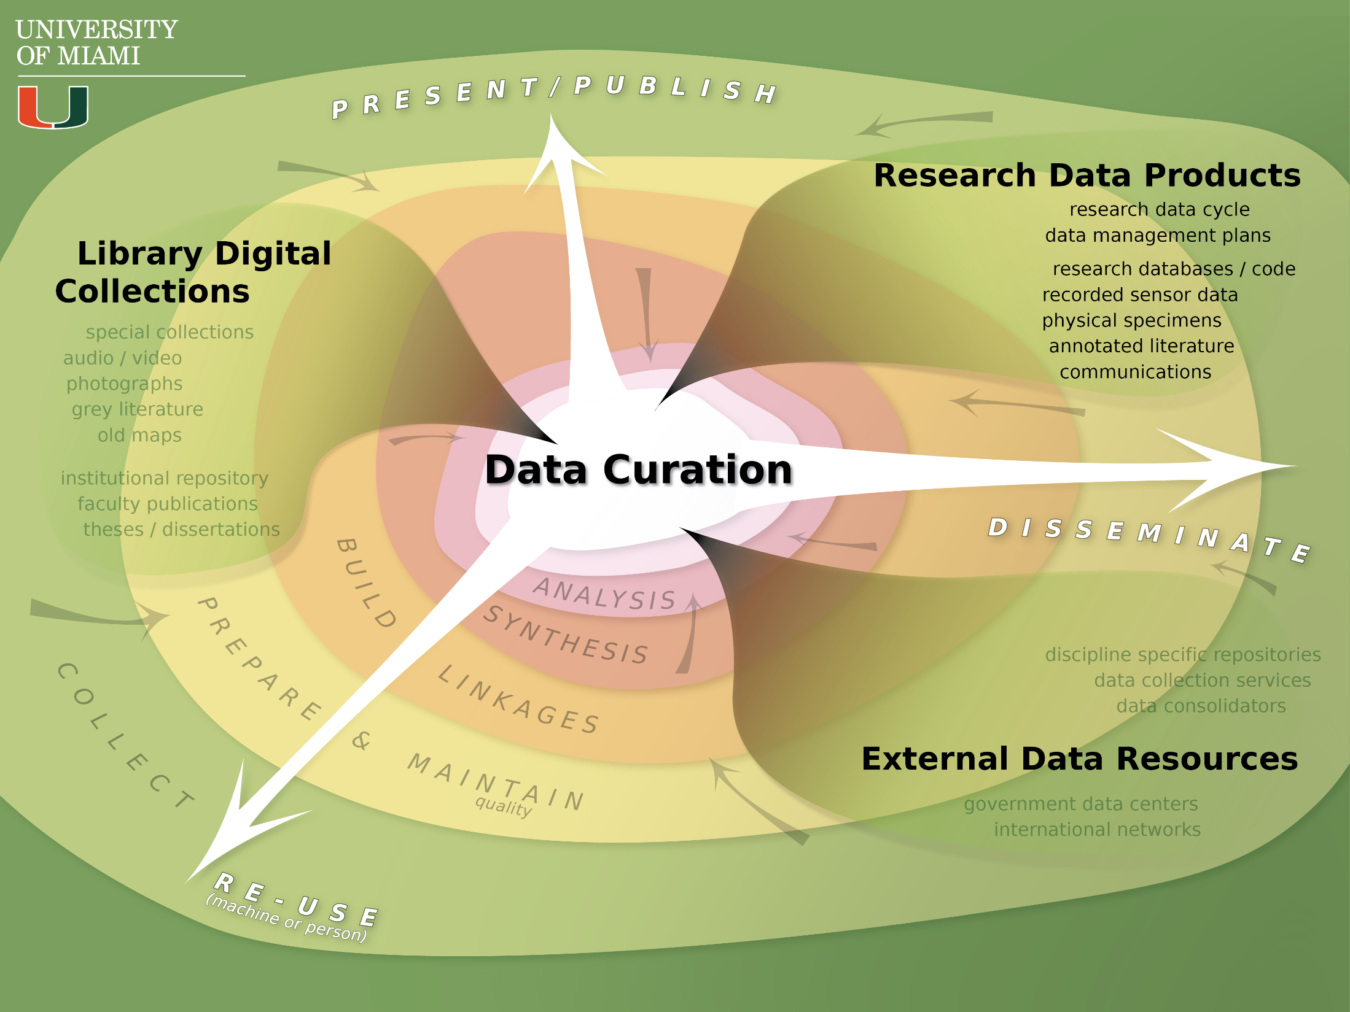
Notes:
The Research Data Cycle:
The 2011 NSF requirement to have data management plans in the grant proposals, now NSF, NEH, NIH all require data management plans
Link back to OSTP and the 2013 memo
CDL now has the widely known DMP tool – many other institutions as well (including a small one at UM lining to the CDL site – institutional affiliation for scholarly use)
Highlight (again) that none of the activities or categories are concrete – this is an abstraction useful for an initial discussion
(illustrator 7)

Slide 16
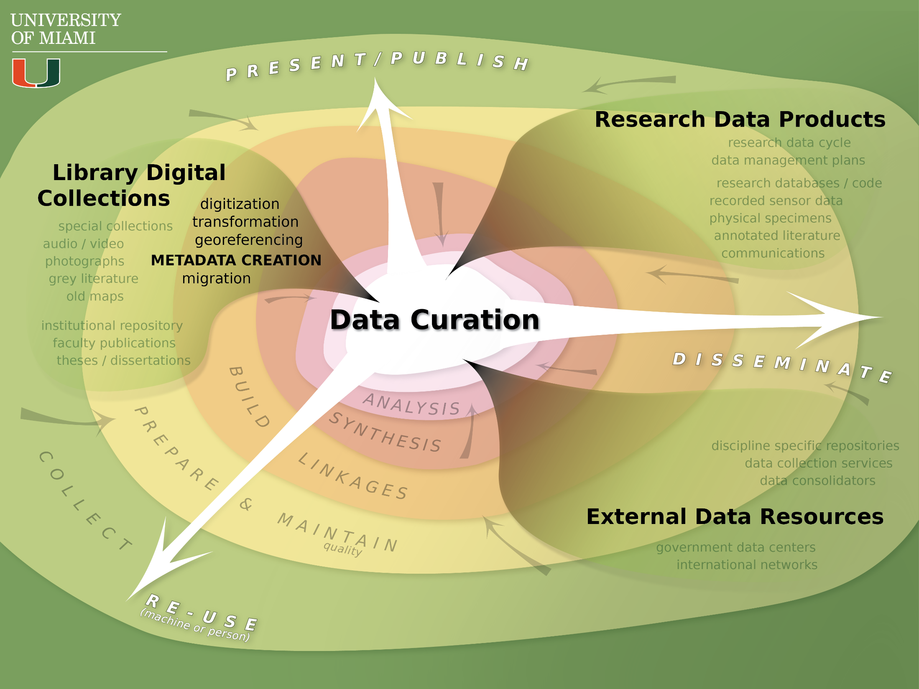
Notes:
Note that all these terms can cross the three general categories of sources and activities
Metadata creation – subject librarians? New human resource that the library needs? Researcher role in metadata creation? Collaborative?
(illustrator 8)

Slide 17
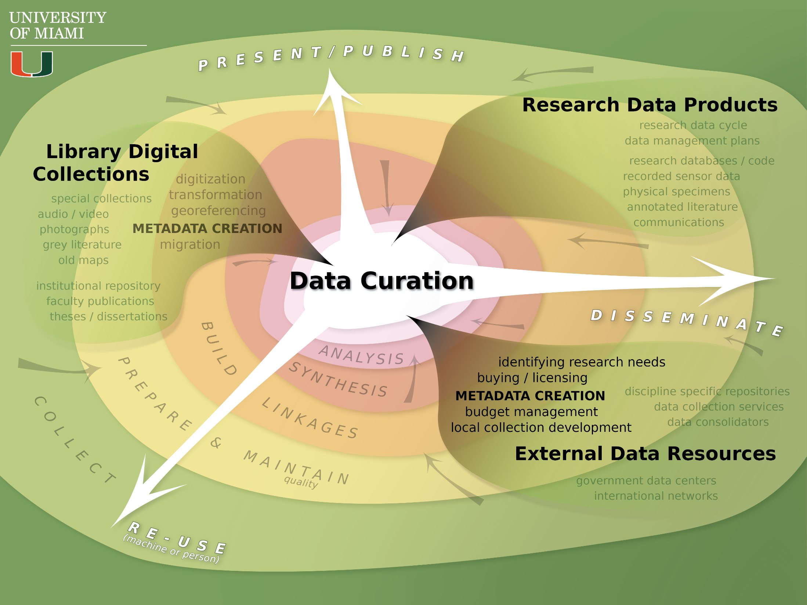
Notes:
(illustrator 9)

Slide 18
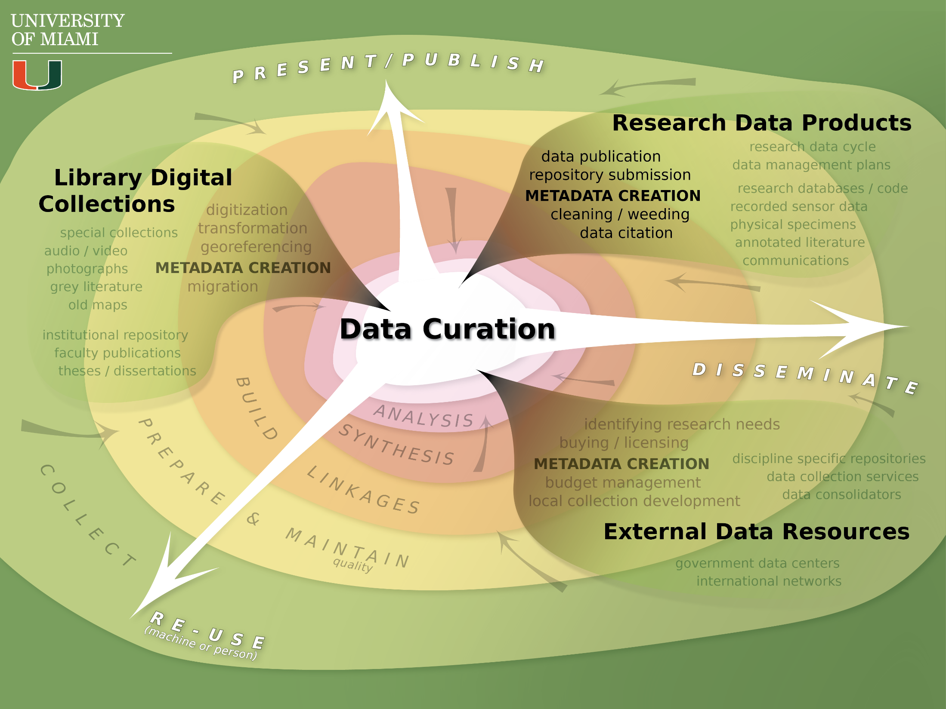
Notes:
This are really calls for a lot of discipline (self-control, monitoring, effort, etc.) on the part of the researcher. Their data must have structure in order to be shared well. This is a NEW aspect of research (in part motivated by NSF, HEH, and NIH requirements, in part as a recognition of the value of data) that we are all scrambling to comply with.
Many Metadata standards both within the library (MARC and Dublin Core being two big ones) and in discipline specific silos (FGDC for GIS [from federal government] or ISO 19100, for ecology EML [from LTER], and so on). Metadata is all about FOLLOWING THE RULES so that the data is interoperable.
DataOne, IPSCR
(illustrator 10)

Slide 19
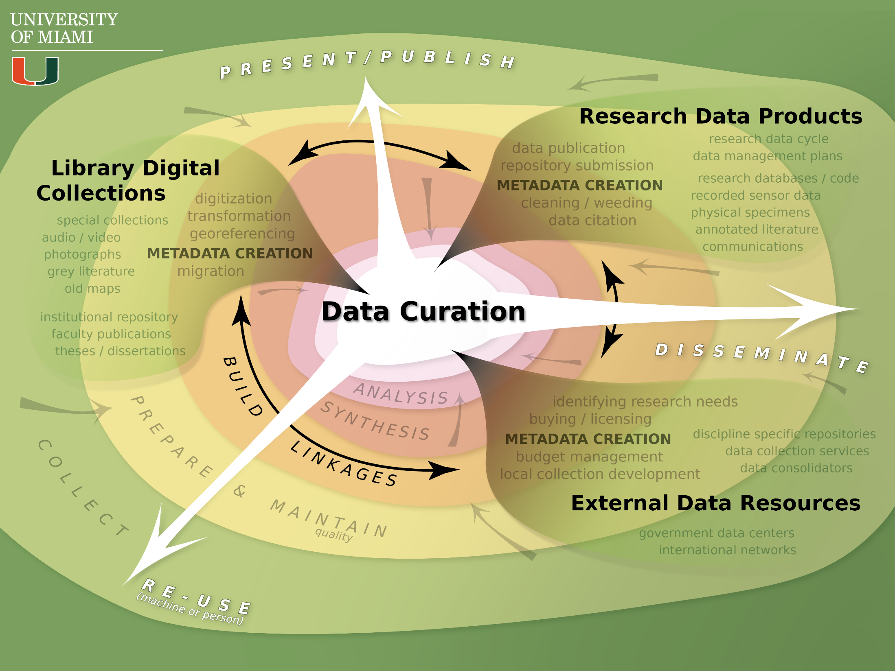
Notes:
This is really the central role of the data curator – create the metadata and then to build linkages to make the data discoverable, useful, available. Some have said a gatekeeper (much like some subject librarians) of what comes into and is made available through the library.
Metadata = Documentation
Although metadata creation can be automatic, it often is very labor intensive and draws on disciplinary expertise.
Who controls the metadata? Is the metadata correct? Subjectivity or “data sense” in small datasets.
Two Problems:
Few Standards for metadata about data
Very labor intensive (cannot automate)
Opportunity for collaboration? How to make important to researcher? It seems that metadata librarians form a secret society that they guard? And researcher can’t be bothered?
Metadata needs to be monitored and perhaps even created in an iterative way.
What is important metadata? source (author), process steps (provenance), accuracy/validity (authority control)
Title, Author/creator,DOI,Date,Description,Format
(illustrator 11)

Slide 20
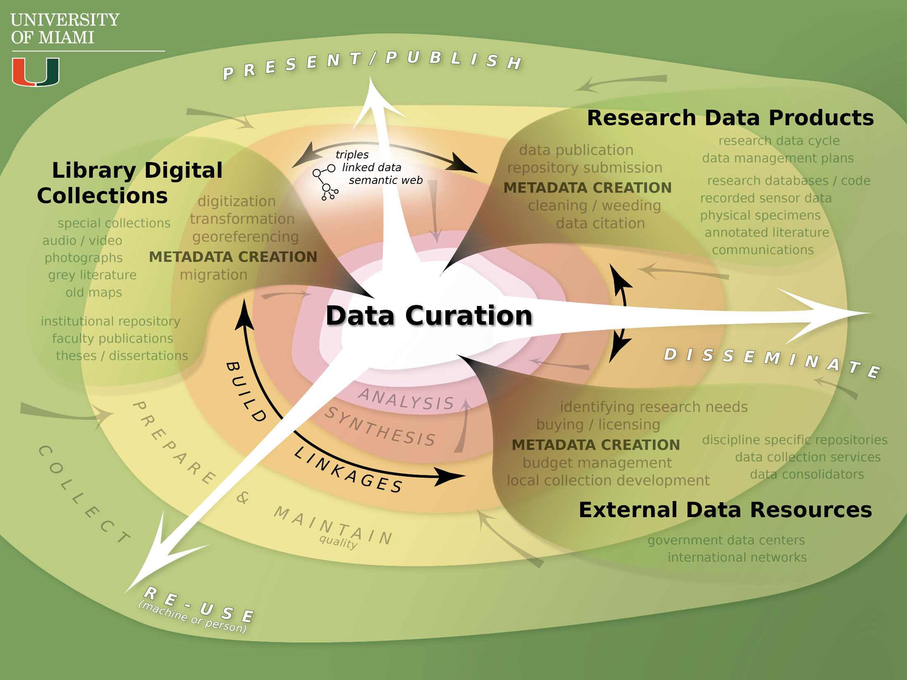
Notes:
Mention the surging interest in the sematic web – not only in libraries but in business world as well (Google, Facecbook, Amazon, and so on)
(illustrator 12)

Slide 21
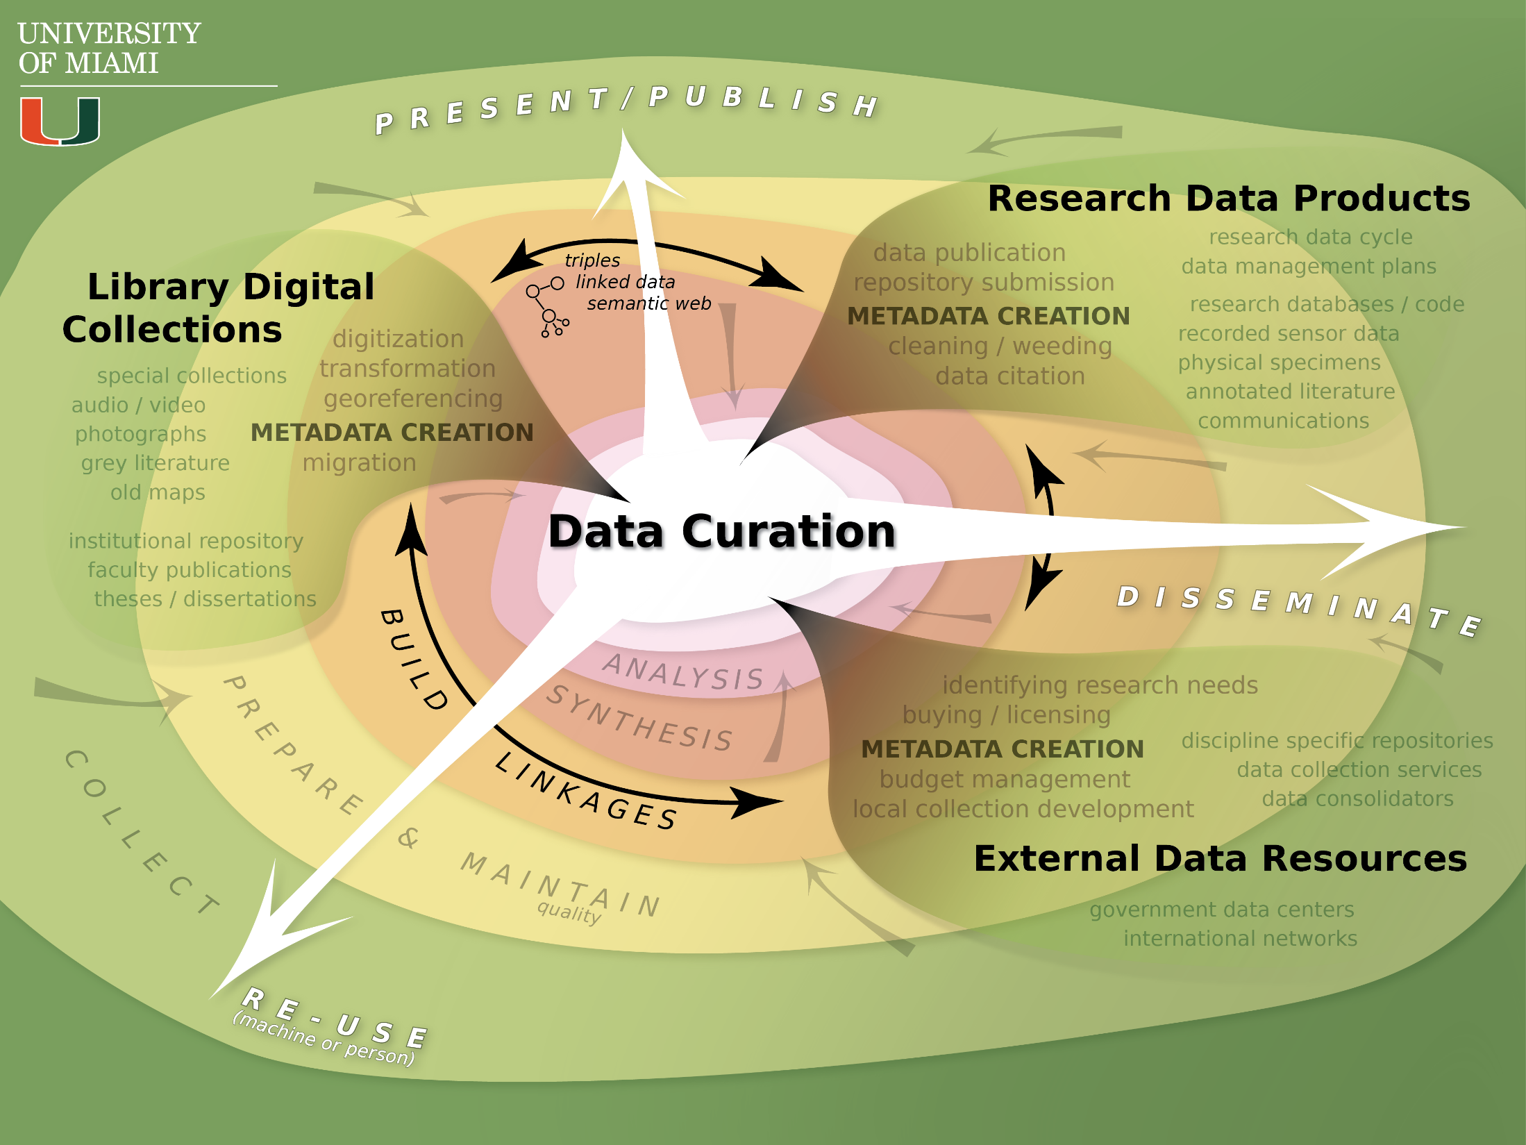
Notes:
Mention the surging interest in the sematic web – not only in libraries but in business world as well (Google, Facecbook, Amazon, and so on)
(illustrator 12)

Slide 22
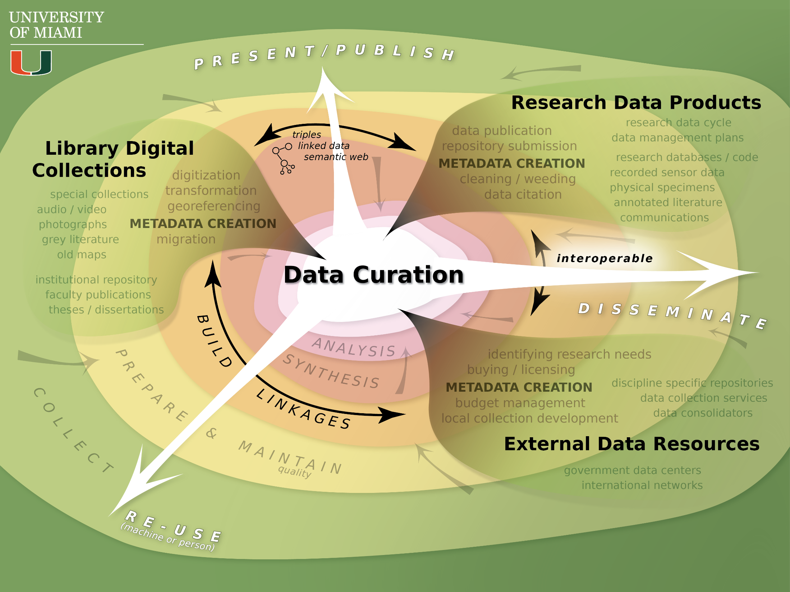
Notes:
And another buzzword, the hope is that all data is interoperable (but what does that really mean)
(illustrator 13)

Slide 23

Notes:
And another buzzword, the hope is that all data is interoperable (but what does that really mean)
(illustrator 13)

Slide 24
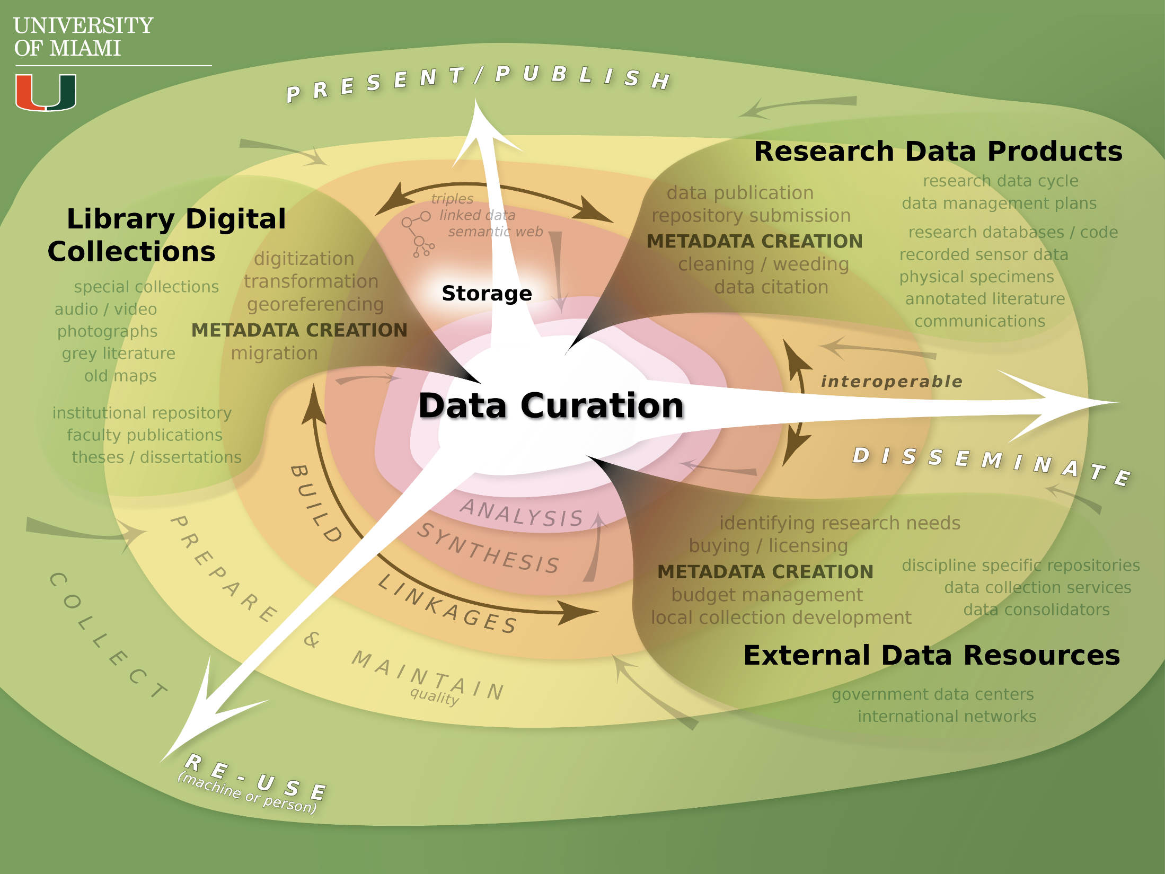
Notes:
Storage as bits on disk, cloud, etc. (backup and restore)
(illustrator 14a)

Slide 25
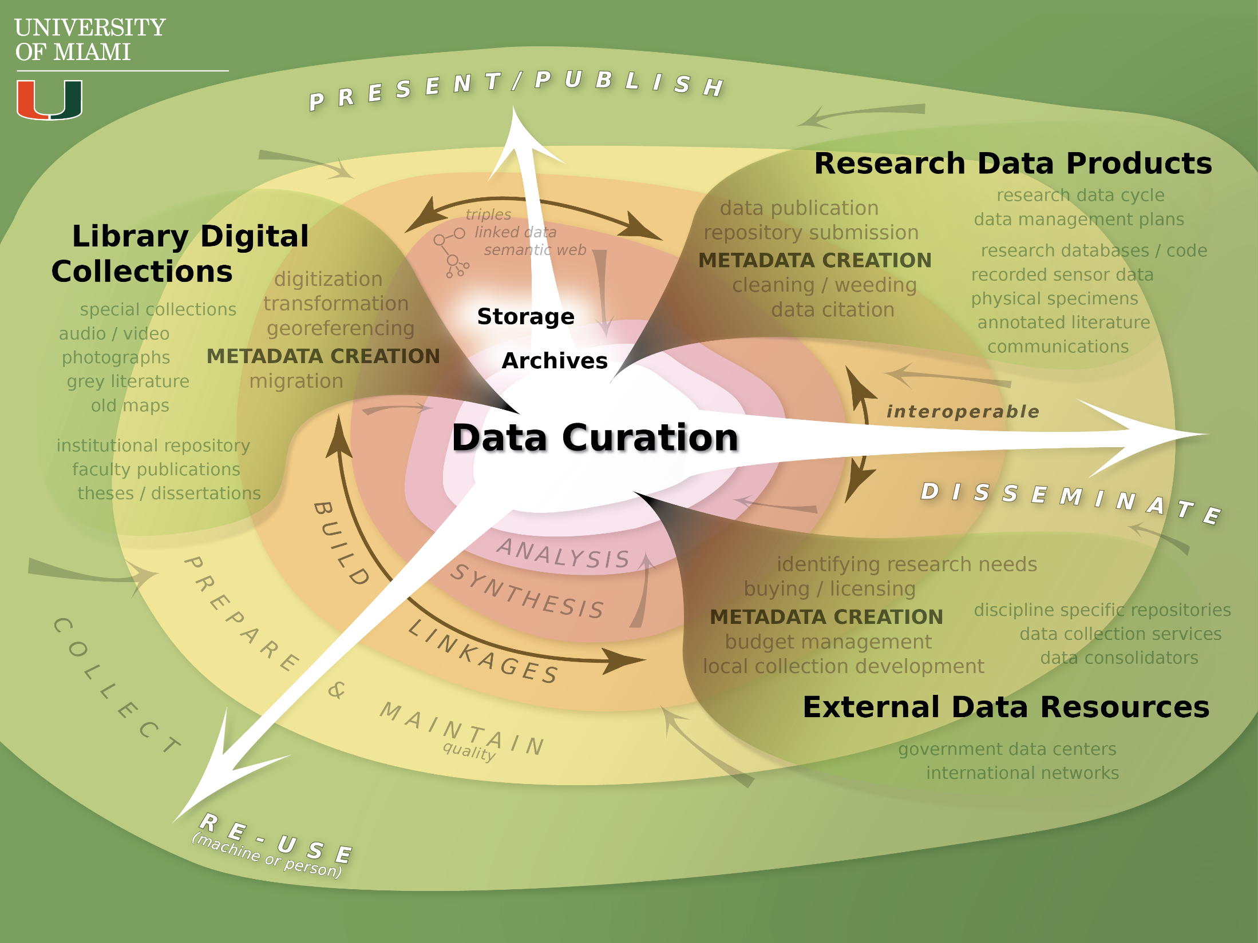
Notes:
Archives as data protection as fixity, identifiers, checksums
[could meet some DMP requirements]
(illustrator 14b)

Slide 26

Notes:
Preservation as the ability for someone other than the data creator to interpret the data
[satisfies DMP requirements]
Curation as adding value – bring disparate data together for new discoveries, searches, inter-disciplinary
This last comparison of library processes and data processes from:
Choudhury, S., Palmer, C., Baker, K., & DiLauro, T. (2013). Levels of services and curation for high-functioning data. Paper presented at the 8th International Digital Curation Conference, Amsterdam.
(illustrator 14c)

Slide 27
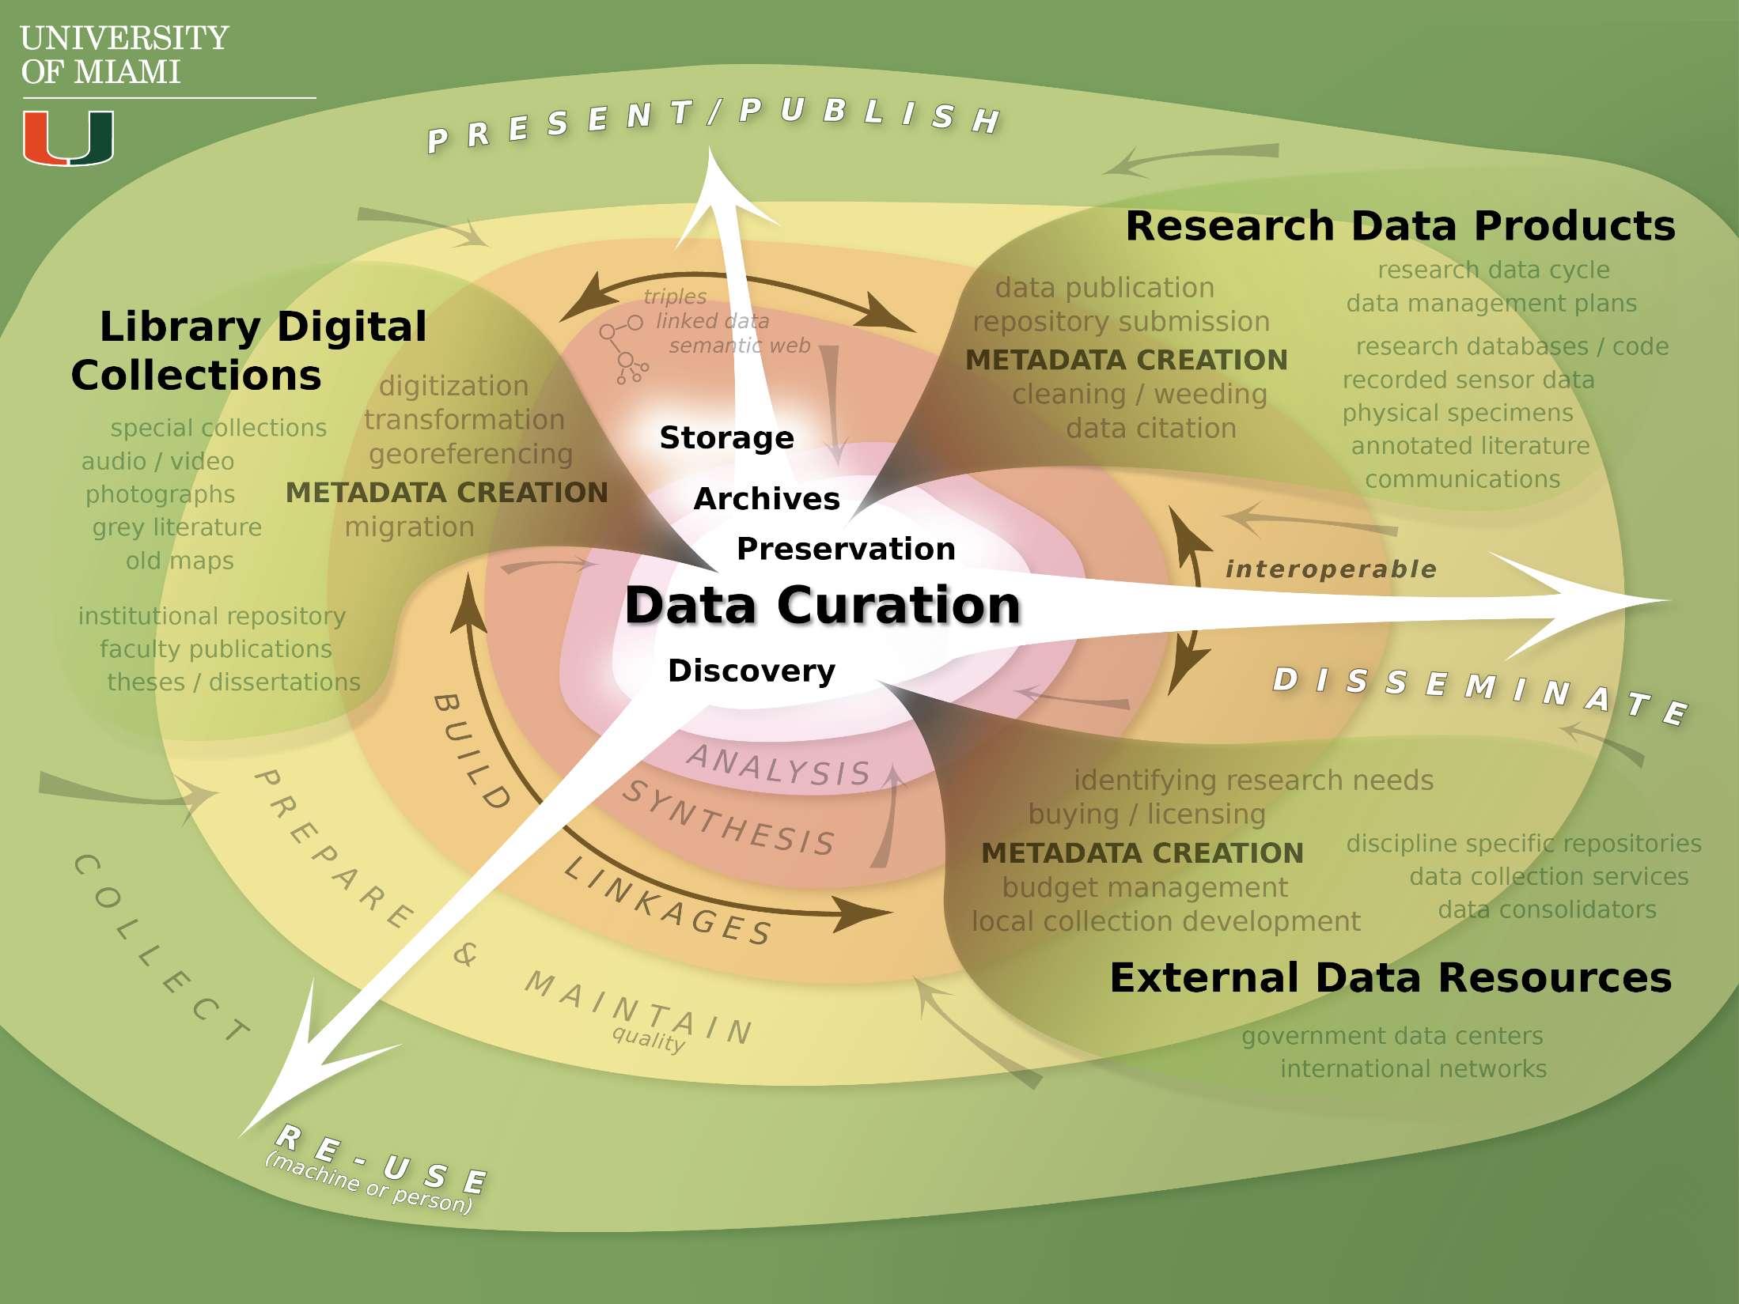
Notes:
Discovery is of course perhaps the most important aspect of data curation – increased value in datasets through re-use in the creation of new knowledge.
(illustrator 14d)

Slide 28
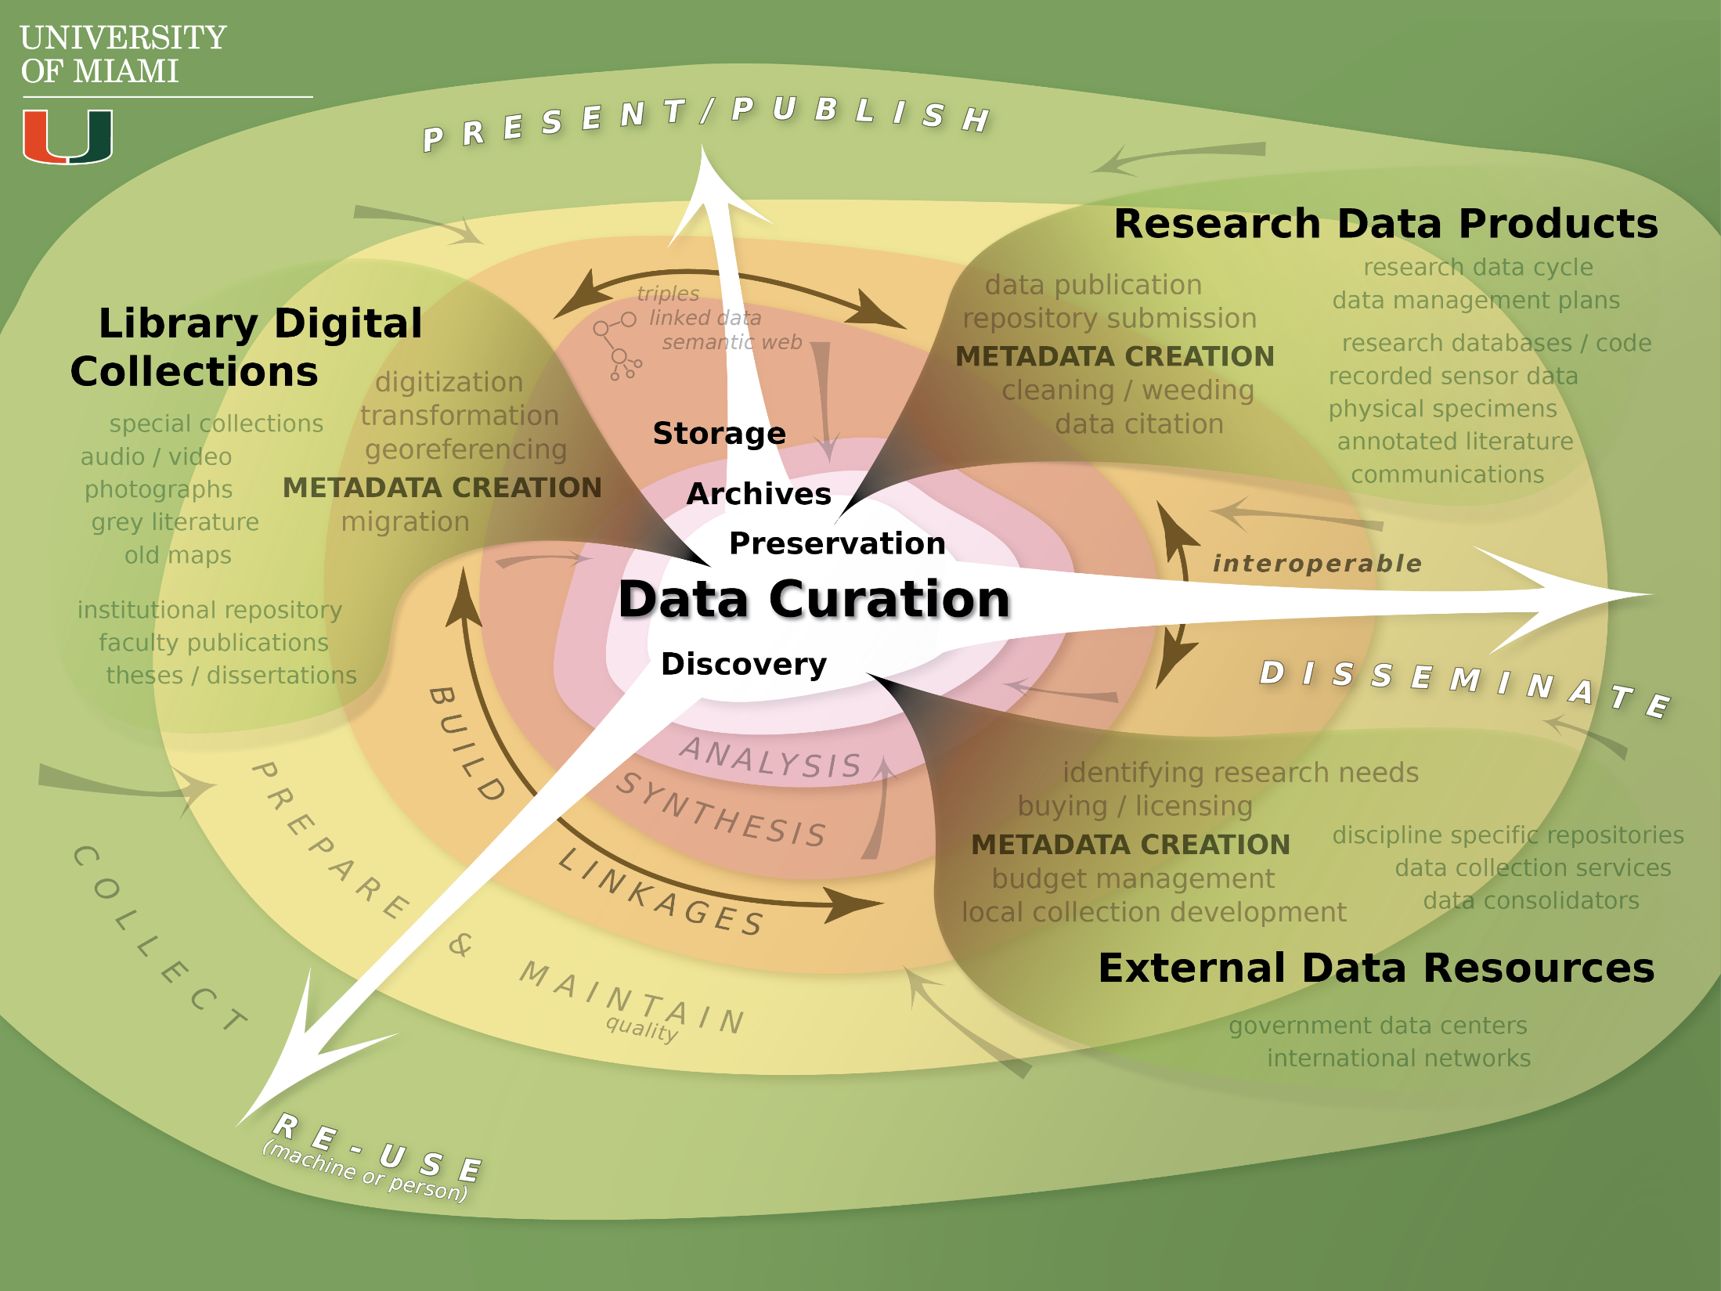
Notes:
Discovery is of course perhaps the most important aspect of data curation – increased value in datasets through re-use in the creation of new knowledge.
(illustrator 14d)

Slide 29

Notes:
Discovery is of course perhaps the most important aspect of data curation – increased value in datasets through re-use in the creation of new knowledge.
(illustrator 14d)

Slide 30

Notes:
Discovery is of course perhaps the most important aspect of data curation – increased value in datasets through re-use in the creation of new knowledge.
(illustrator 14d)

Slide 31
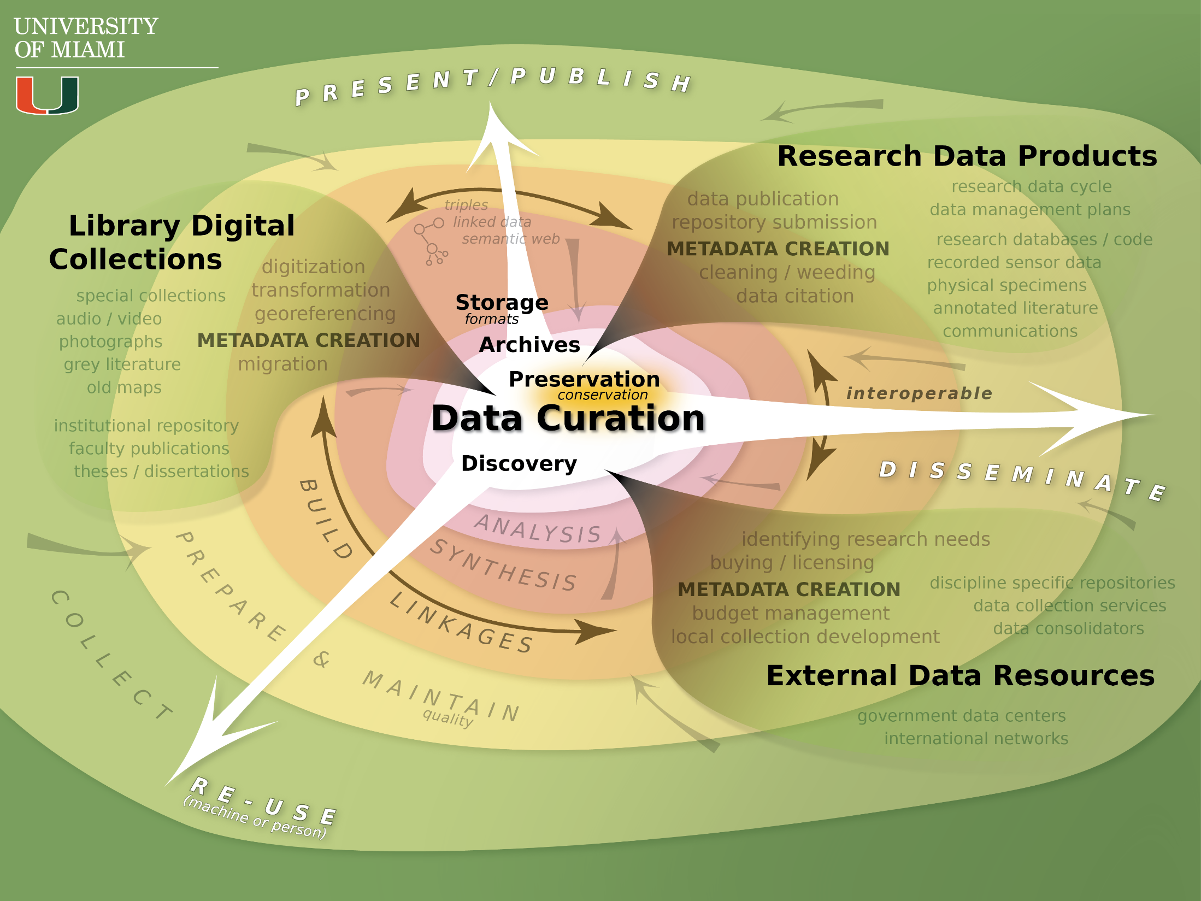
Notes:
Note that in the material world, there is a tension between preservation and conservation (in economics and natural resource management). This conversation has not yet appeared in library land, but perhaps it is part of a well thought out future of data curation.
(illustrator 15)

Slide 32

Notes:
Note that in the material world, there is a tension between preservation and conservation (in economics and natural resource management). This conversation has not yet appeared in library land, but perhaps it is part of a well thought out future of data curation.
(illustrator 15)

Slide 33

Notes:
The next four slides outline a little of the curation infrastructure. Note that much of this infrastructure already exists, no need to create more, just build the right relationships.
(illustrator 16)

Slide 34

Notes:
Just some things to think about with discovery infrastructure, databases, access control, and the search technology
(illustrator 17)

Slide 35

Notes:
Notes on the curation infrastructure
re-emphasize that most of the infrastructure already exists – the data curation aspect is a matter of identifying needs and opportunities to match needs with existing curation networks (perhaps even in museums or other physical collections).
The open source/proprietary debate remains undecided as of yet, but there is a sort of an open source movement taking place (perhaps shared with an egalitarian vision of information sharing in the future – OSTP connection?)
(illustrator 18)

Slide 36

Notes:
As the data moves to re-use and dissemination we have a world of issues regarding property rights (largely understood as rights to income streams). These issues will likely never be static (resolved 100%) and will endure as society adapts to novel technologies, networks, and flows of data. Things to pay attention to: Creative Commons licensing and the open access movement in journal publishing.
(illustrator 19)

Slide 37
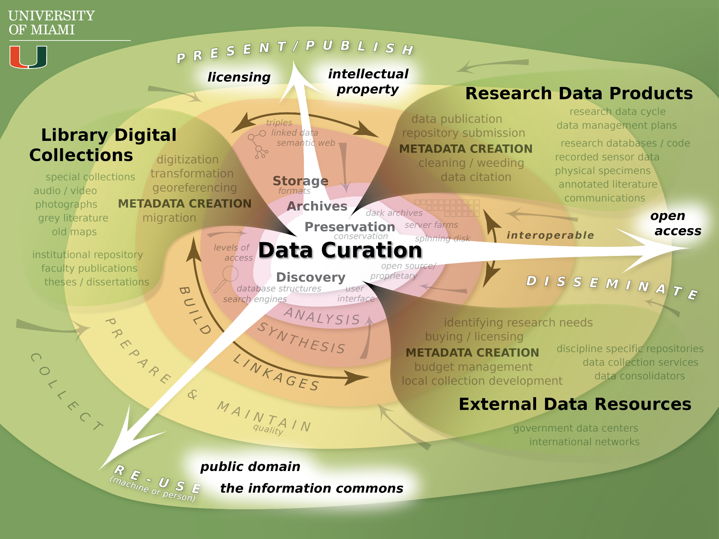
Notes:
As the data moves to re-use and dissemination we have a world of issues regarding property rights (largely understood as rights to income streams). These issues will likely never be static (resolved 100%) and will endure as society adapts to novel technologies, networks, and flows of data. Things to pay attention to: Creative Commons licensing and the open access movement in journal publishing.
(illustrator 20)

Slide 38
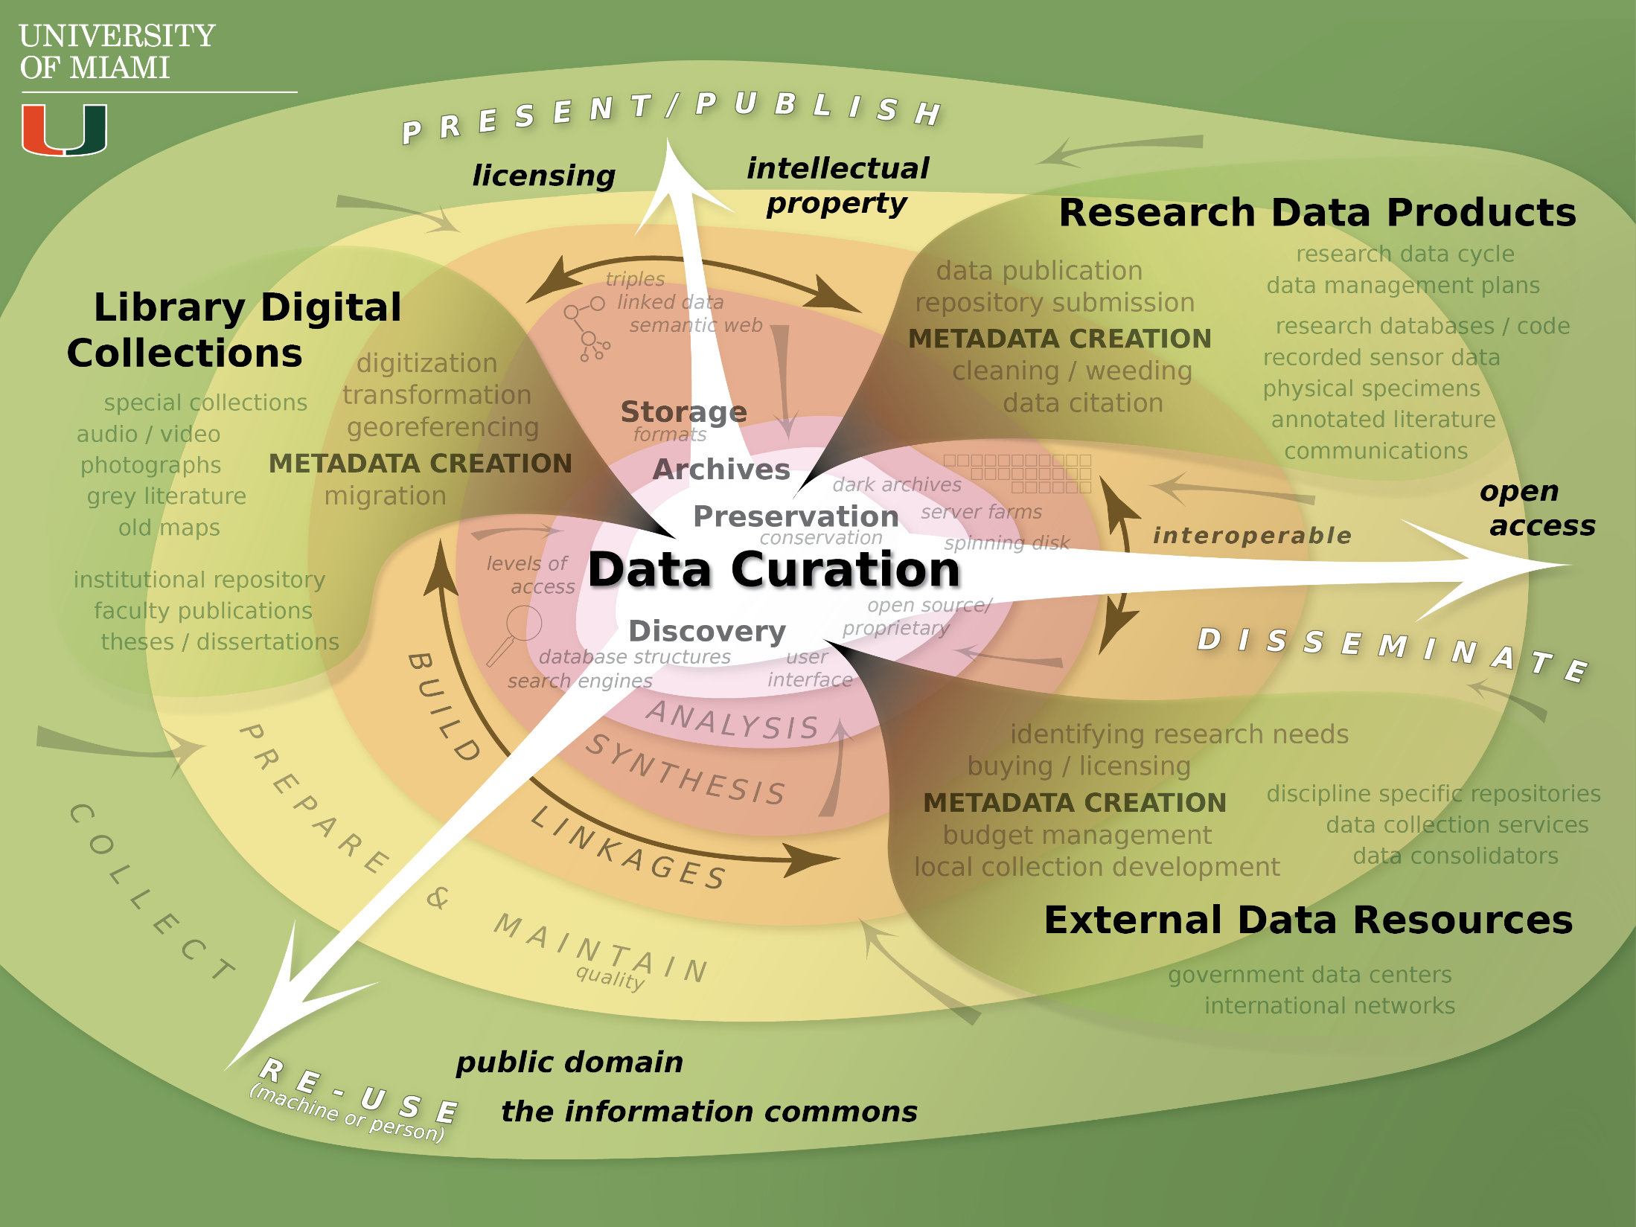
Notes:
As the data moves to re-use and dissemination we have a world of issues regarding property rights (largely understood as rights to income streams). These issues will likely never be static (resolved 100%) and will endure as society adapts to novel technologies, networks, and flows of data. Things to pay attention to: Creative Commons licensing and the open access movement in journal publishing.
(illustrator 20)

Slide 39
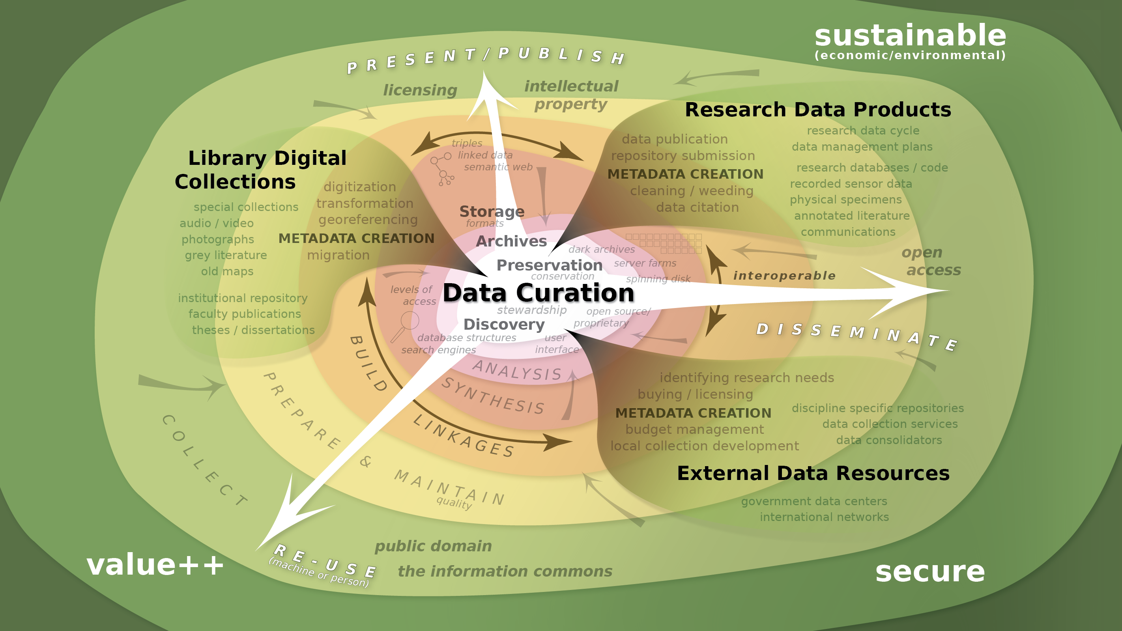
Notes:
Emphasize that we will return to the concepts of sustainability, value (growth) and trust at the end of the presentation.
End of very general description . . . a breathing circular process . . .
Note that growth and security were perhaps the two most influential concepts in the 20th C in terms of ecology and sustainability. Perhaps the biggest buzzwords of the 20th century.
McNeill, J. R. (2000). Something New Under the Sun: an environmental history of the twentieth-century world. New York: W.W. Norton and Company, Inc.
(illustrator 3)

Slide 40
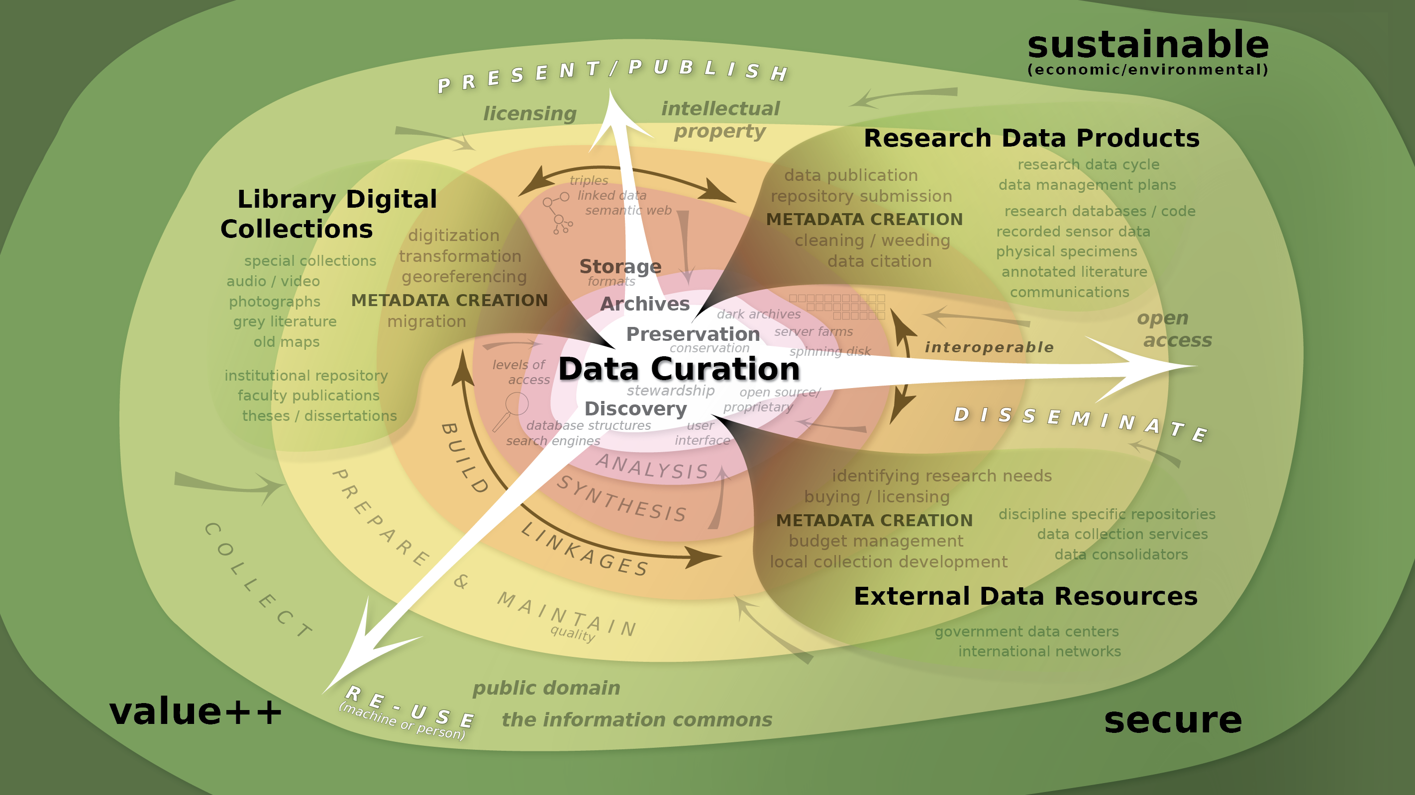
Notes:
Emphasize that we will return to the concepts of sustainability, value (growth) and trust at the end of the presentation.
End of very general description . . . a breathing circular process . . .
Note that growth and security were perhaps the two most influential concepts in the 20th C in terms of ecology and sustainability. Perhaps the biggest buzzwords of the 20th century.
McNeill, J. R. (2000). Something New Under the Sun: an environmental history of the twentieth-century world. New York: W.W. Norton and Company, Inc.
(illustrator 3)

Slide 41
Notes:
So we are left with this complex view (strategic pause)
Re-emphasize the role of the curator as a collaborator in the creation of metadata and a builder of relationships.
Copyright and access metadata? Who polices? Is the metadata stable? Are links persistent? GATEKEEPERS
(illustrator 20)

Slide 42
The Data Curation Profile
A completed Data Curation Profile will contain two types of information about a data set. First, the Profile will contain information about the data set itself, including its current lifecycle, purpose, forms, and perceived value. Second, a Data Curation Profile will contain information regarding a researcher’s needs for the data including how and when the data should be made accessible to others, what documentation and description for the data are needed, and details regarding the need for the preservation of the data.

Slide 43
The Data Curation Profile
The original idea
A completed Data Curation Profile will contain two types of information about a data set. First, the Profile will contain information about the data set itself, including its current lifecycle, purpose, forms, and perceived value. Second, a Data Curation Profile will contain information regarding a researcher’s needs for the data including how and when the data should be made accessible to others, what documentation and description for the data are needed, and details regarding the need for the preservation of the data.
Represents researcher needs and perspectives
Suitable for sharing (inform the library community) (?)

Slide 44
The Data Curation Profile
For This Class
A completed Data Curation Profile will contain two types of information about a data set. First, the Profile will contain information about the data set itself, including its current lifecycle, purpose, forms, and perceived value. Second, a Data Curation Profile will contain information regarding a researcher’s needs for the data including how and when the data should be made accessible to others, what documentation and description for the data are needed, and details regarding the need for the preservation of the data.
“Provides a means for a researcher or a research group to thoughtfully consider their needs beyond immediate use

Slide 45
The Data Curation Profile
For This Class
A completed Data Curation Profile will contain two types of information about a data set. First, the Profile will contain information about the data set itself, including its current lifecycle, purpose, forms, and perceived value. Second, a Data Curation Profile will contain information regarding a researcher’s needs for the data including how and when the data should be made accessible to others, what documentation and description for the data are needed, and details regarding the need for the preservation of the data.
Inform data management. Do you curate data???

Slide 46
The Data Curation Profile aka “The Data Story”
Specific data set or research project
Interview, conversation, perhaps a survey form to fill out
Could be done with any discipline (?) or any kind of data (?)
Modular, choose parts/components to use from the toolkit

Slide 47
A Data Curation Profile is developed through 3 stages:
Stage 1 – Preparation
Stage 2 – Interviews
Stage 3 – Constructing the Profile

Slide 48
Sections of a DCP
Summary of Curation Needs
Overview of the Research
Data Types, Formats, & Stages
Intellectual Property
Organization and Description of Data
Ingest
Sharing and Access
Discovery
Tools
Interoperability
Measuring Impact
Data Management
Preservation
Personnel

Slide 49
Preparation
Faculty Website
Faculty’s publications (at least one)
Seminars?
Press releases?
Grants awarded (check their CV)?

Slide 50
The Interview
Is there a maximum time – be aware!
This all depends on the engagement and level of interest
Rule of thumb, not longer than one hour
How much material to cover
Do what you can, do not panic if you don’t get everything
The importance of listening to a rant to get some good information
Kinds of Questions
Surveys: free text/short answer/menu choice/yes or no/Likert scale
Interviews: explanatory/clarifying/probing/relational

Slide 51
Types of Questions
“Tell me why you selected “x” as your response”
“Could you explain what you mean by “x”?
“Could you tell me more about “x”?
“Could you tell me how “x” relates to your earlier
response of “y”?
Explanatory –
Clarifying –
Probing –
Relational –
Whitmire, Amanda L. (2014). Research Data Management Curriculum, Lecture 6: Introducing Data Curation Profiles. Oregon State University Libraries

Slide 52
The in depth interview
How many people involved?
Who manages?
How is data produced?
Software and hardware used?
Are the data static
or dynamic?
How are they processed or analyzed?
{Demographics}
The Data Story
Characteristics of the Data
Ownership of the Data
Data Management Challenges
Backup Strategies
Organization and Documentation
Data Sharing (internal and external)
Data Preservation
Average size of data?
What is their final form?
Time frame for production?
Formats used?
Number of files?
Licenses?
What are the data levels ?
Purchases?
Inter-institutional?
Where are the data?
How many copies?
Can you share?
Agency required?
Size problems?
Data Management Plan?
Do you want to share?
Metadata standard?
Problems?
Data dictionaries?
Successes?
How much is preserved?
Do you deposit in a repository?
What will the data be worth in 10 years?

Slide 53
Interview Recording
NO!
INSTEAD
Take a set of questions written or printed on paper (the interview guide)
Take copious notes right onto your interview guide
As soon as the interview is complete, type notes into a computer

Slide 54
Example for Data
Data Stage | Output | Typical File Size | Format | Other / Notes
Primary Data
Raw
Processing Stage 1
Processed
Analyzed
Published
Ancillary Data
Image
Carlson, Jake, "The Data Curation Profiles Toolkit: The Profile Template" (2010). http://dx.doi.org/10.5703/1288284315653

Slide 55
Example for Data
Data Stage | Output | Typical File Size | Format | Other / Notes
Primary Data
Raw | Sensor data | 100k in 1 file per day | proprietary to the sensor | FTP downloads are mostly automated.
Processing Stage 1 | Sensor data –open/accessible format | Roughly 6kb | .csv / .xls | Data are formatted into .csv before bring reformatted into a mySQL database.
Processed | Data vectors | 800 records per intersection per day. | SQL / .xls | Data are extracted from the mySQL database for analysis purposes.
Analyzed | charts/ Graphs |  | .xls / .emf | charts and graphs used for interpretation.
Published | charts/ graphs |  | .ppt | Data are presented via power point.
Ancillary Data
Image | Stills taken from video |  | .gif /.jpg / .ppt | Images generated from video.
Whitmire, Amanda L. (2014). Research Data Management Curriculum, Lecture 6: Introducing Data Curation Profiles. Oregon State University Libraries

Slide 56
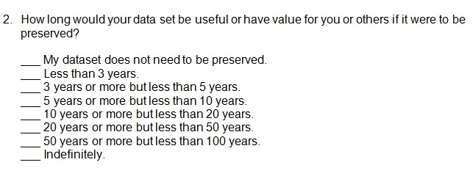
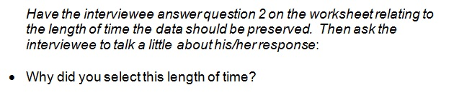
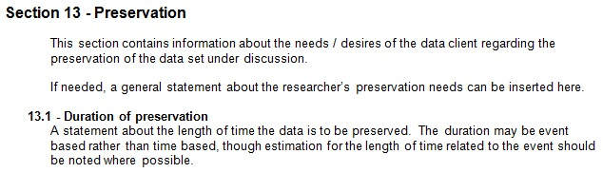
Connections b/w components
Interview
Worksheet
Interview Manual
DCP
Template
Whitmire, Amanda L. (2014). Research Data Management Curriculum, Lecture 6: Introducing Data Curation Profiles. Oregon State University Libraries

Slide 57
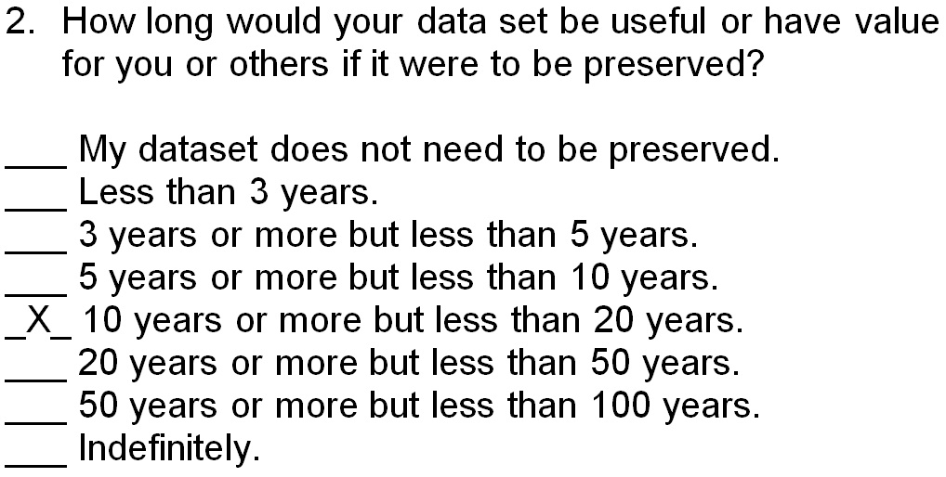
Worksheet Mod.13 Q2
Interview Worksheet
Whitmire, Amanda L. (2014). Research Data Management Curriculum, Lecture 6: Introducing Data Curation Profiles. Oregon State University Libraries

Slide 58
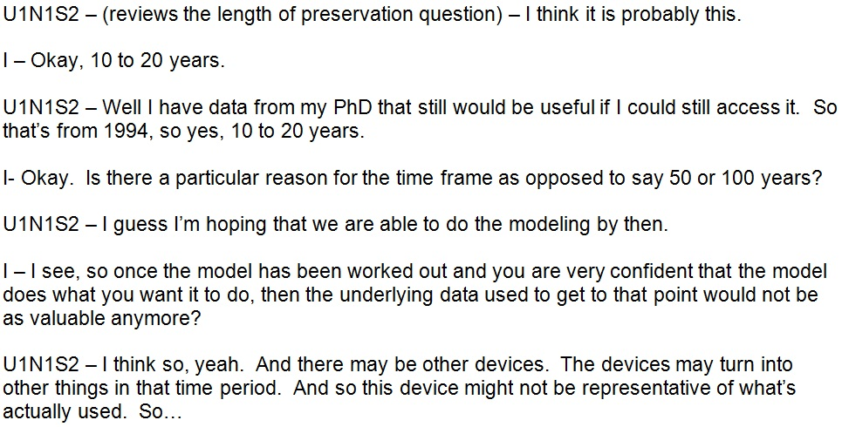
Manual: Mod 13 Q2
Whitmire, Amanda L. (2014). Research Data Management Curriculum, Lecture 6: Introducing Data Curation Profiles. Oregon State University Libraries

Slide 59
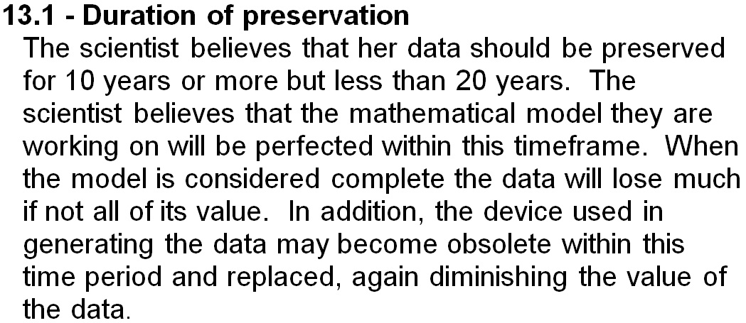
Connections b/w components
Section 13.1 of the Completed Data Curation Profile
Whitmire, Amanda L. (2014). Research Data Management Curriculum, Lecture 6: Introducing Data Curation Profiles. Oregon State University Libraries

Slide 60
** break **

Slide 61
Reminder for Midterm Format
Double spaced - Simple page numbers - 1” margins
12pt font (preferably Times New Roman)
1000 – 1500 words (strict)
At least one reference (the paper you read)
Headings and sub-headings ok
All written work is a draft.
A second draft is always better than the first.
This is a writing exercise as well as a DCP.
http://riotindustries.com/words/the-secret-lives-of-fonts/
Due: March 4th 2016

Slide 62
Reading for Wednesday
Choose one data curation profile to read from:
http://docs.lib.purdue.edu/dcp/
Be prepared to discuss the DCP in class
2-3 minute summary
3-5 points that you found interesting

Slide 63
